Slide 1
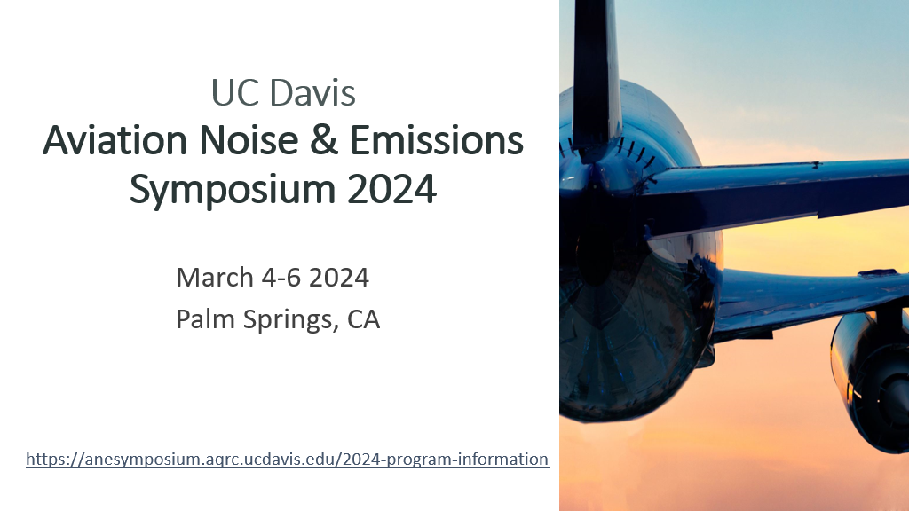

Slide 2
TABLE OF CONTENTS​
SESSION ONE - Community Engagement: Best Practices and Innovative Approaches​ Pg. 3 - 7
SESSION TWO - Reframing Community Exposures to Better Capture Aviation Related Health Effects​ Pg. 8 - 12
SESSION THREE - Beyond the Part 150 – Finding Noise Abatement Solutions​ Pg. 13 - 36
SESSION FOUR - Perspectives on Environmental Impacts and Environmental Justice​ Pg. 37
SESSION FIVE - Conquering Regional Air Transportation with a Reduced Noise Footprint (AAM)​ Pg. 38 - 47
SESSION SIX - Innovative Strategies for Quantifying and Communicating Aviation Noise Impacts​ Pg. 48 - 56
SESSION SEVEN - Climate Change and Aviation​ Pg. 57
SESSION EIGHT - Measuring and Modeling Air Quality Emissions​ Pg. 58
SESSION NINE/Keynote Speaker - Leaded Aviation Gasoline Exposure Risk in San Jose, California​ Pg. 59 - 64
SESSION TEN/Keynote Speaker - Working Together on Land Use Compatibility​ Pg. 65 -78
SESSION ELEVEN - Noise Policy Review Update​ Pg. 79 - 90
Takeaways Pg. 91
Appendix
Symposium Link: https://anesymposium.aqrc.ucdavis.edu/2024-program-information​
Author: Alicia Avery, Member VNY CAC

Slide 3
SESSION ONE
Community Engagement: ​
Best Practices and Innovative Approaches
The SEA Stakeholder Advisory Round Table: Focusing on the Art of the Possible
  Marco Milanese, Port of Seattle & Eric Schinfeld, Port of Seattle/Seattle-Tacoma International Airport ​
Communities Look for Solutions
  Julie Shane, Noise Advisory Committee at Portland International Jetport
    Presented the effort their community has done to reduce the impact of overflights with the goals to increase air traffic over water, increase runway use to/from the west for noise reduction at night, and monitor flight tracks for compliance.
    Stated that Jetport & Noise Advisory Committee need to work together to identify ways to encourage compliance.​
    Effecting change needs broad representation and commitment – Representatives from the Airport, FAA, aviation businesses and all impacted communities need to be be involved in discussions and committed to potential solutions and proposed changes.
FAA and AICA Noise Policy Review Webinar – A Community Engagement Example
  Don Scata, FAA & Darlene Yaplee, Aviation-Impacted Communities Alliance (AICA)
https://anesymposium.aqrc.ucdavis.edu/2024-program-information#CommunityEngagement

Slide 4

SESSION ONE (Cont’d)
The SEA Stakeholder Advisory Round Table: Focusing on the Art of the Possible
SEA Airport, one of the busiest commercial airports in the country - located in a dense residential and commercial area immediately south of Seattle – creating tension between the economic benefits of airport operations versus community concerns about aircraft noise and emissions. ​Community reacts not only to the amount of noise but also the change to the amount of flights.
StART OVERVIEW
  A collaborative community forum that brings together the airport, community members, local governments, airlines and the FAA to identify and implement tangible progress on these issues.​
  Supports meaningful and collaborative public dialogue and engagement
  Raises public knowledge about the airport and its impacts
  Focuses on practical, achievable solutions to address concerns about the airport by the near-airport cities.
  Consultant serves as facilitator
  Airport Manager serves as chair
  Cities appoint two community reps and one city employee
  Steering Committee guides StART’s focus
  Inaugural meeting: early 2018

Slide 5
SESSION ONE (Cont’d)
StART: Successes
AVIATION NOISE WORKING GROUP - Runway Use Plan, Late Night Noise Limitation Program, Monthly noise complaint reporting
Become the venue where airport impacts are discussed and tackled
Only venue that brings together all the key players with a collective purpose: airport, airlines, FAA and the community
Demonstrated that the airport doesn’t just talk – it acts
Improves the overall relationship and advances other shared priorities
StART: Challenges
Airports have very limited authority on addressing impacts/implementing mitigation
Change at the federal level moves slowly
Lack of trust in airport (stemming from past activities) takes time to rebuild
FAA’s involvement fluctuates
Community member participation is uneven

Slide 6

Don Scata | Federal Aviation Administration (FAA)
Darlene Yaplee | Aviation-Impacted Communities Alliance (AICA)
SESSION ONE (Cont’d)
FAA and AICA Noise Policy Review Webinar
A Community Engagement Example
The Webinar – Purpose
Discuss the FAA Noise Policy Review framework and to facilitate the submission of meaningful comments by members of local communities who are substantially affected by aircraft noise and noise impacts.
Protocols
- FMCS served as impartial moderators and led the discussion
- No press was present
- Recordings of any kind were not allowed
- Prepared questions and live follow up questions
  Five categories: metrics and thresholds, applicability/retroactivity, health effects, external engagement, and accessibility

Slide 7
SESSION ONE (Cont’d)
The Webinar - Format
FAA Noise Policy Review - FAA and AICA Panel Discussion July 13, 2023 – hosted via Zoom, 6:30-8:30pm ET
Panelists for FAA: Don Scata, Manager Noise Division (AEE-100) Krystyna Bednarczyk, Environmental Policy Advisory, Environmental Policy Division (AEE-400)
Panelists for AICA: Darlene Yaplee – Co-founder, President Dr. Cindy Christiansen – Co-founder, Chief Technology Officer Amy McCoy – Founding Member, Groton Ayer Buzz, GA Liaison
Moderators for Federal Mediation and Conciliation Service (FMCS) Kayla Mack, Commissioner Moira Caruso, Commissioner and Strategy Officer
ATTENDEES
Over 111 individuals and 55 community groups
FAA noise policy team members
Webinar invitation
https://aviationimpactedcommunities.org/wp-content/uploads/2023/09/FAA-x-AICA-NPR-Dialogue_Invitation.pdf
Webinar notes issued by AICA
https://aviationimpactedcommunities.org/wp-content/uploads/2023/09/FAA-AICA-Meeting-Notes_2023_Final.pdf

Slide 8
SESSION TWO
Reframing Community Exposures to Better Capture Aviation Related Health Effects​
Investigating the Impact of Airport-related Ultrafine Particles and Cancer: The MultiEthnic Cohort Study
  Iona Cheng, University of California, San Francisco​
Aircraft Sound is a Form of Pollution and Should be Treated as a Public Health Hazard
  Bryan Johnson, Community Researcher​
The FAA Allows Americans to be Exposed to Unsafe Levels of Aviation Noise
  Daniel Fink, The Quiet Coalition
https://anesymposium.aqrc.ucdavis.edu/2024-program-information#HealthEffects

Slide 9
SESSION TWO (Cont’d)
Investigating the Impact of Airport-related Ultrafine Particles and Cancer: The MultiEthnic Cohort Study
Iona Cheng, University of California, San Francisco​
  Examined cancer risk in relation to ultrafine particles exposures from Los Angeles International Airport.
  These studies investigate the associations between airport-related ultra fine particle exposures and cancer risk.
  Ultrafine Particles (UFPs) can be deposited throughout airways and penetrate into the blood stream and carried through the circulation. They can also cross the blood brain barrier.
  Routine monitoring of UFPs are not available in the U.S. and in most countries.
  LAX-related UFPs were 4-5 times greater than background levels in downwind communities for extended distances, likely due to descending jets.
  Future directions – Expand UFP exposure assessment to other airports.
    Evaluate additional environmental factors: multiple pollutants and noise.
    Develop partnerships with community and policy stakeholders to advocate for maintaining air quality standards to define clean air.

Slide 10
SESSION TWO (Cont’d)
Aircraft Sound is a Form of Pollution and Should be Treated as a Public Health Hazard
Bryan Johnson, Community Researcher
The FAA Allows Americans to be Exposed to Unsafe Levels of Aviation Noise
Daniel Fink, The Quiet Coalition
Both speakers believe the long-standing premise for the FAA Aircraft Sound Criteria does not work and in fact can’t be defended for aircraft noise
The health impacted zone/health risk zone is much larger than the DNL boundaries. DNL is flawed.
Bryan Johnson created an experiment designed to measure the duration of the full sound spectrum of aircraft flyovers/designed to measure aircraft sounds. Recording both sound and vibrations induced into solid surfaces from the sound energy.
  The findings concluded that the current FAA approved aircraft sound criteria and methodology does not include the vast majority of sound being produced by aircraft as their primary sound is either not measured at all or its presence is significantly subtracted from the overall sound produced through the use of the manipulations associated with the dB(A) sound weighting.
  Low Frequency Aircraft Noise – sound transmitted by aircraft noise causes vibrations in solid surfaces. This energy can also cause vibrations within the human body.
Mr. Fink believes this allows Americans to be exposed to unsafe levels of aviation noise, with poor and minority communities disproportionately affected. Aviation noise exposure can be reduced immediately by operational changes and other the longer term by engine and airframe modification.
  Aviation noise annoyance a not a trivial problem. Each episode of aviation noise disrupts conversations, interrupts activities, disturbs sleep, decreases productivity.
  For impacted communities, the effects extend far beyond annoyance to stress, anger, frustration, and a sense of powerlessness.

Slide 11
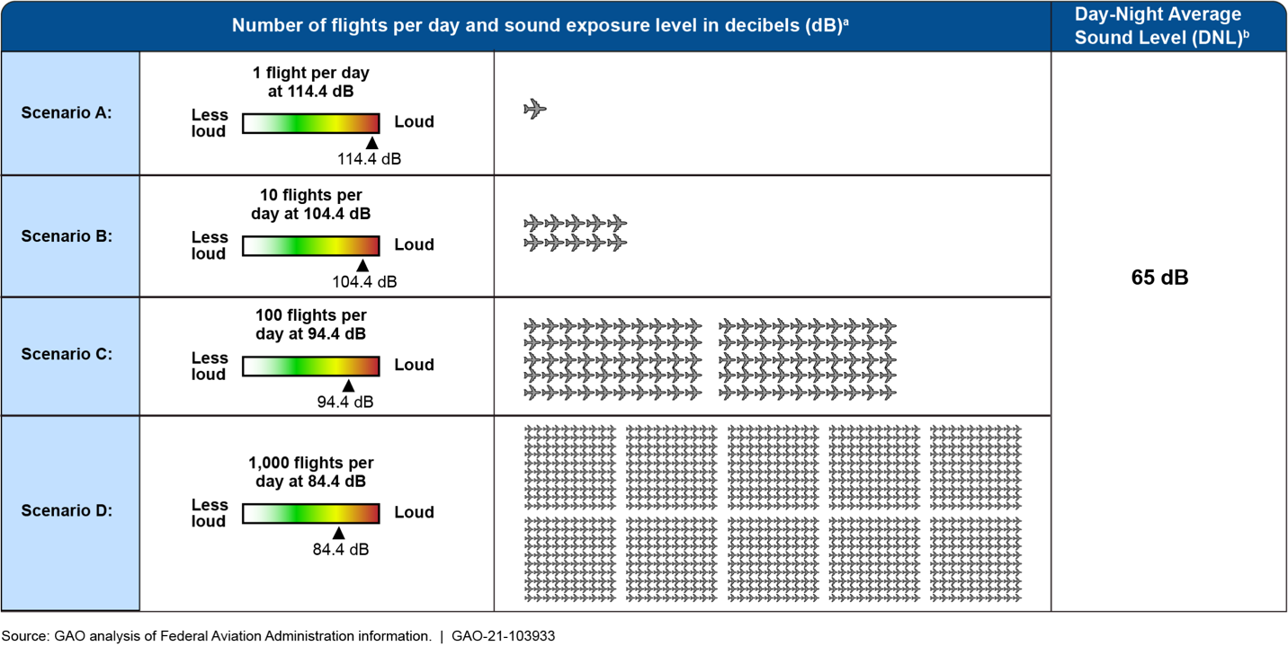
Is DNL the correct metric for aircraft noise?
SESSION TWO (Cont’d)
Day-night Sound Level (DNL) Defined as the average sound energy in a 24-hour period with a 10-dB penalty added to the nighttime levels (10:00 p.m. to 7:00 a.m.).
  Equivalent Operations For DNL = 65
  1 Event/Day SEL 114.4 dBA = DNL 65
  10 Events/Day SEL 104.4 dBA = DNL 65
  100 Events/Day SEL 94.4 dBA = DNL 65
    (FAA webpage, Fundamentals of Noise and Sound)
Figure 2. Different Numbers of Flights and Sound Exposure Levels Result in a Day-Night Average Sound Level (DNL) of 65 Decibels. Reproduced from Government Accountability Office, Aircraft Noise: FAA could improve outreach through enhanced noise metrics, communication, and support to communities

Slide 12
Other metrics for aviation noise
SESSION TWO (Cont’d)
Number of noise events (NNE)
Number-of-events Above a Specified Level, NA. This metric is usually denoted by NAL(X)'. The NA metric calculates the total number of aircraft events (X) that exceed a selected sound level threshold (L) during a specified time period. The threshold is usually defined using either the SEL or L_{max} metric.

Slide 13
SESSION THREE
Beyond the Part 150 – Finding Noise Abatement Solutions
Completed Part 150: What's Next?
  Zachary Burch, Naples Airport Authority​
PANYNJ Fly Quiet Program
  Adeel Yousuf & Jacob Atwood, Port Authority of New York & New Jersey​
Communicating Noise Abatement Information in the Chart Supplement
  Beth White, FAA​ (Pilots)
A Regional Approach to Addressing Airplane Noise and Emissions Concerns
  Matt Liknaitzky, Sling Pilot Academy​
Community Perspective – Fly Quiet Programs
  Tami Mulcahy, Sky Posse Los Altos
https://anesymposium.aqrc.ucdavis.edu/2024-program-information#NoiseAbatement

Slide 14
BEYOND
PART 150
SESSION THREE (Cont’d)
Zachary Burch
Senior Communications Manager

Slide 15
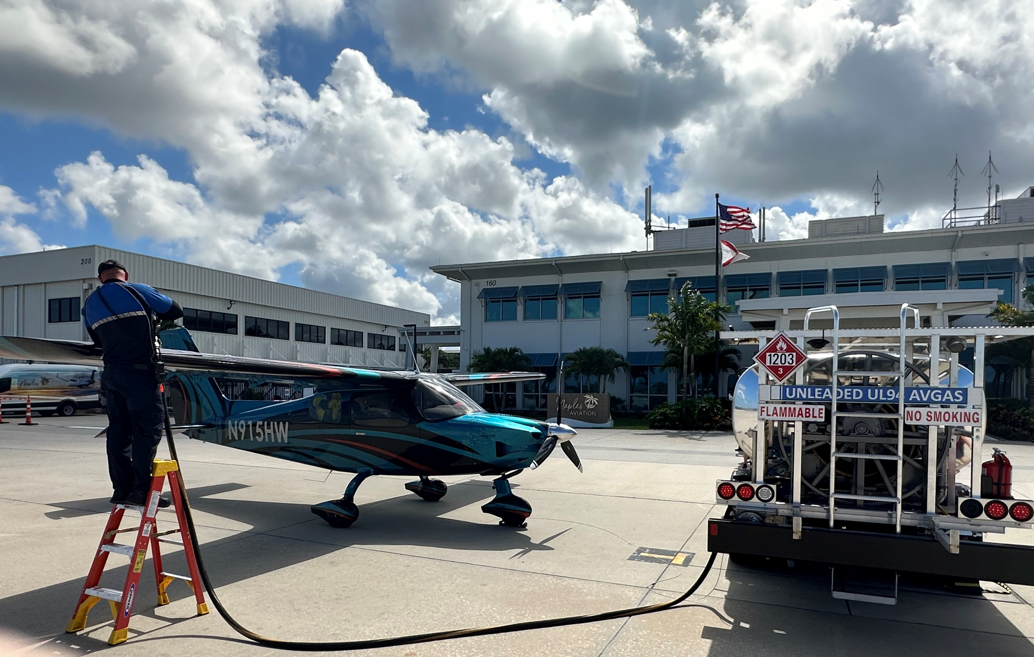
UNLEADED FUEL / UL 94
SESSION THREE (Cont’d)
In June 2023 the NAA began offering UL 94 unleaded avgas
Cost to NAA was higher than traditional avgas
NAA purchased special fuel truck
Repurposed only avgas tank in fuel farm to store UL 94 in its place
Numerous training and safety protocols put in place to prevent misfuelling
UL 94 INCENTIVES
NAA subsidizes the cost of UL 94 for tenants equal to cost of full-service avgas.
Estimated NAA loss per gallon:
  June 2023- $5.65 / gallon
  February 2024- $1.70 / gallon
NAA pays the $100 cost of obtaining the required Supplemental Type Certificate (STC)
NAA pays the $150 cost of an A&P mechanic inspection
FY 23/24 budget for incentives- $182,500
UL 94 has replaced nearly 20% of FY 24 avgas sales

Slide 16
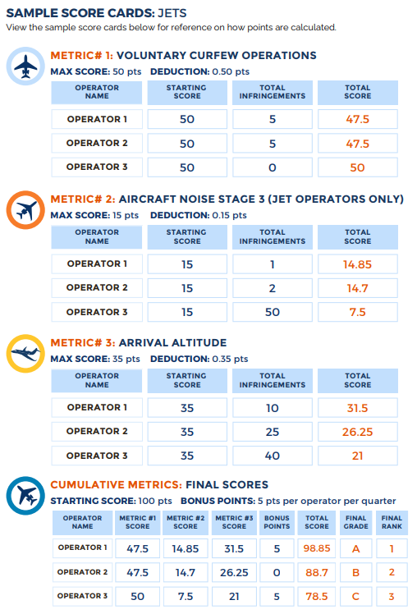
SESSION THREE (Cont’d)
FSFQ LEADERBOARD
In late 2023, the NAA created a new recognition program
FSFQ Leaderboard program evaluates aircraft in 3 categories:
  Arrival altitude
  Voluntary Curfew Compliance
  Jet Noise Stage
Operators are divided by aircraft category:
  Jet
  Turbo Prop
  Piston
The top three operators in each will be recognized as the 1st, 2nd and 3rd place winners in each category
  Initial recognition will be done through public acknowledgement including social media, press release, and newspaper and industry publications

Slide 17
SESSION THREE (Cont’d)
Adeel Yousuf & Jacob Atwood, Port Authority of New York & New Jersey​

Slide 18
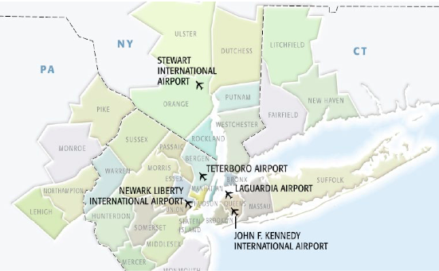
REGION
SESSION THREE (Cont’d)
5 PANYNJ Airports
(JFK, LGA, EWR, TEB, SWF)
TEB is GA
  2 runways
  170,000 aircraft movements (General Aviation)
  Existing Fly Quiet Program

Slide 19
SESSION THREE (Cont’d)

Slide 20

A Regional Approach to Addressing Airplane Noise and Emissions Concerns
Matt Liknaitzky, Sling Pilot Academy
SESSION THREE (Cont’d)
Sling Pilot Academy has approached airplane noise as a regional problem.
Started in 2011 as a regular recreational flight school - Now one of the largest flight schools in Los Angeles (Torrance & San Diego)​
Meeting the critical needs of severe pilot shortage
Quiet Airplanes
Unleaded Gas
Voluntary Noise Abatement Procedures
Export as much of our noise to other airports as possible

Slide 21
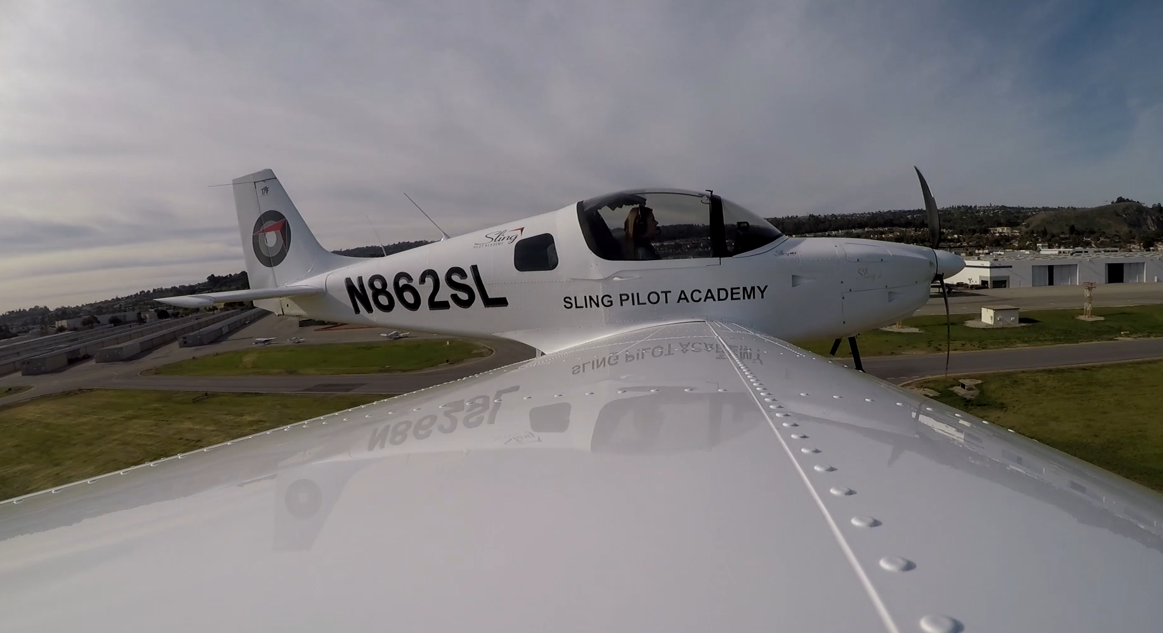
Quiet(er) Airplanes:
Sling NGT: Next Generation Trainer
SESSION THREE (Cont’d)

Slide 22

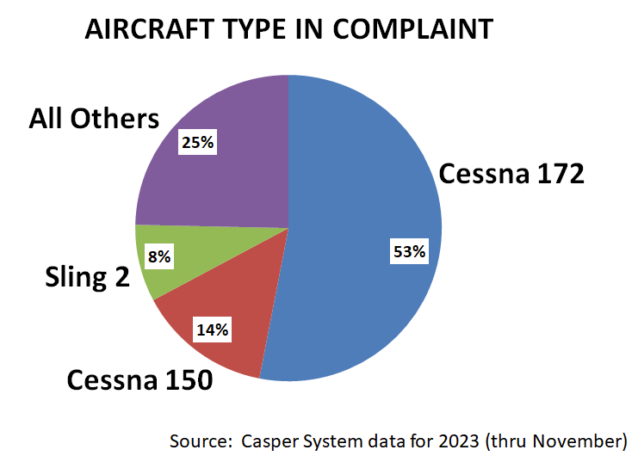
Low Emissions
Rotax 912iS: Only 3.5 GPH of Unleaded Gasoline
SESSION THREE (Cont’d)
Community Concern: Airplane Noise Complaints
Small Percentage of Noise Complaints:
  Complaints made to the City of Torrance via their Casper System show that Sling generates a very small percentage of complaints versus other airplanes
Their City Council started a working group which brought airport operators, pilots and residents together to try to understand and workshop the problem.
Great results - including a Voluntary Noise Abatement Procedures from our Academy addressing the largest pain point, the hill to the South of the Airport.

Slide 23
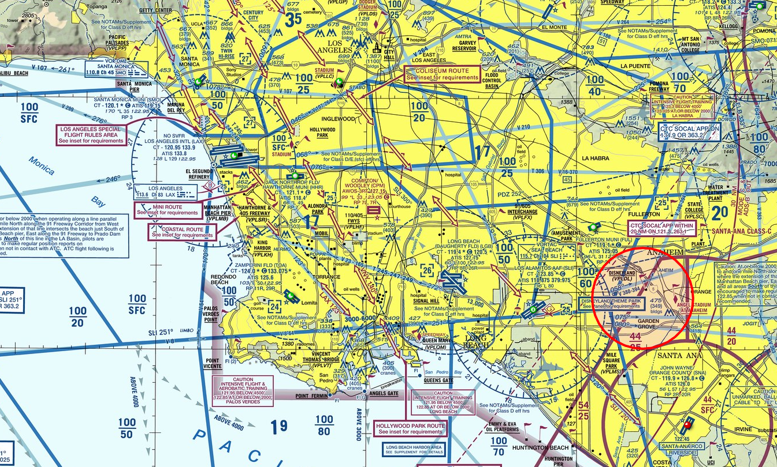
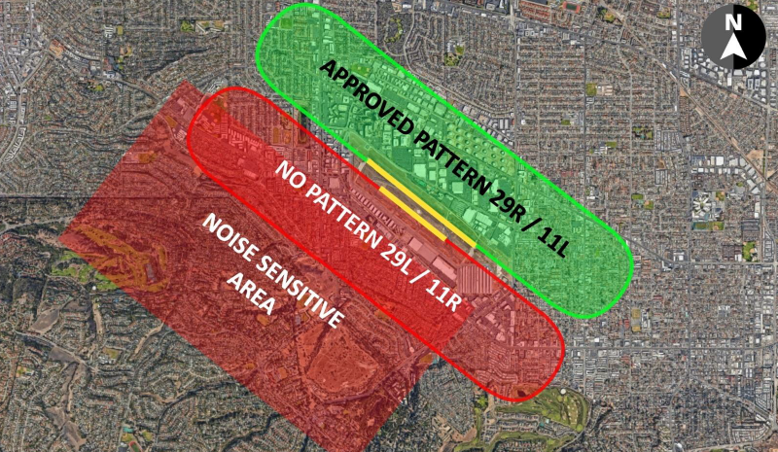

Community Engagement:
Voluntary Letter of Agreement
SESSION THREE (Cont’d)
The City process works towards a Voluntary Letter of Agreement (LOA), taking into consideration resident comments and work done between the various airport operators, flight schools and pilot groups.
One of the points that the City pushes in the draft LOA is an agreement to ‘utilize other airports when possible’ when doing flight training.
Voluntary Noise Mitigation Procedures
Sling Pilot Academy gives up half of the operations available at their airport in January 2023.

Slide 24
This Issue is Regional: We Need to Approach it Regionally
SESSION THREE (Cont’d)
CONCLUSION
It is clear we cannot solve this issue airport by airport. We need to educate all pilots about all airports in the region.
Listen to the Community: Develop Voluntary Fly Friendly Procedures
We are beyond arguing that “you moved near an airport, what did you expect?”
Talking to the community can help identify the real pain points.
Developing Voluntary Fly Friendly Procedures in EXCESS of existing procedures can help alleviate some of the pressure.
When pilots and aircraft operators ignore and dismiss resident complaints, the residents take them to their City Councils.
Resident Education: Flight Training is Critical and Essential
It has to go hand-in-hand with resident education, since that is important for residents to understand why airplanes fly in the paths that they do/importance of flight training as a part of our critical infrastructure (pilot shortage). Without flight training there are no new pilots and existing pilots lose their pilot privileges.

Slide 25
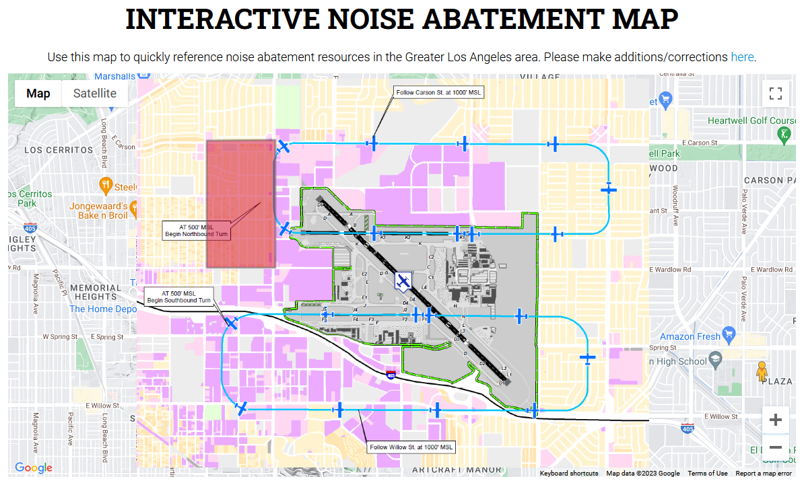
Conclusion Cont:
Pilot Education: Fly Friendly SoCAL
SESSION THREE (Cont’d)
To make it easier for pilots to easily find Noise Abatement and Fly Friendly materials for airports in the region, Sling and other local flight school found the Fly Friendly SoCal consortium.
This group invites pilots and operators to join the group, make the Fly Friendly Pledge, and it gives a single source for Noise Abatement information and education for the Southern California region, with quick links.

Slide 26
Acoustic Research & Development
3 Areas of Improvement
SESSION THREE (Cont’d)
Recognizing that noise annoyance is subjective, we did hundreds of tests using the human ear as our primary testing instrument. We then focused on 3 sources of noise:
  Engine exhaust noise
  Engine compartment noise (acoustic resonator)
  Propeller noise
Acoustic Research & Development - RESULTS
The results of this R&D are a much more pleasing sound and a 50% decrease in sound level.
Recent tests at Santa Monica and Long Beach Airports came back with a result:
DNR – Did Not Register

Slide 27
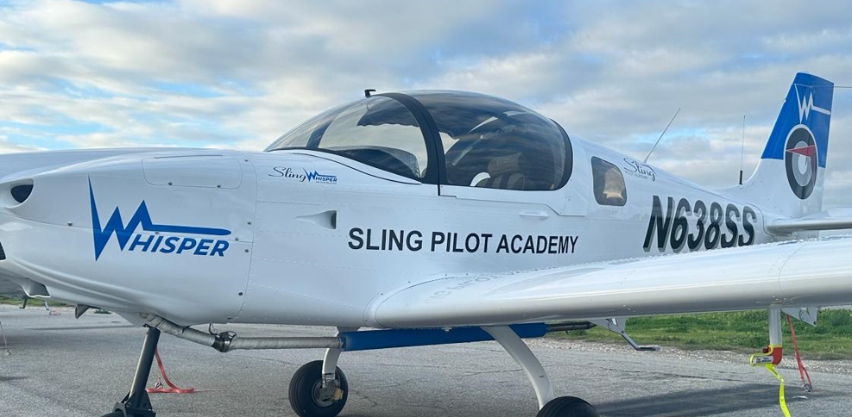
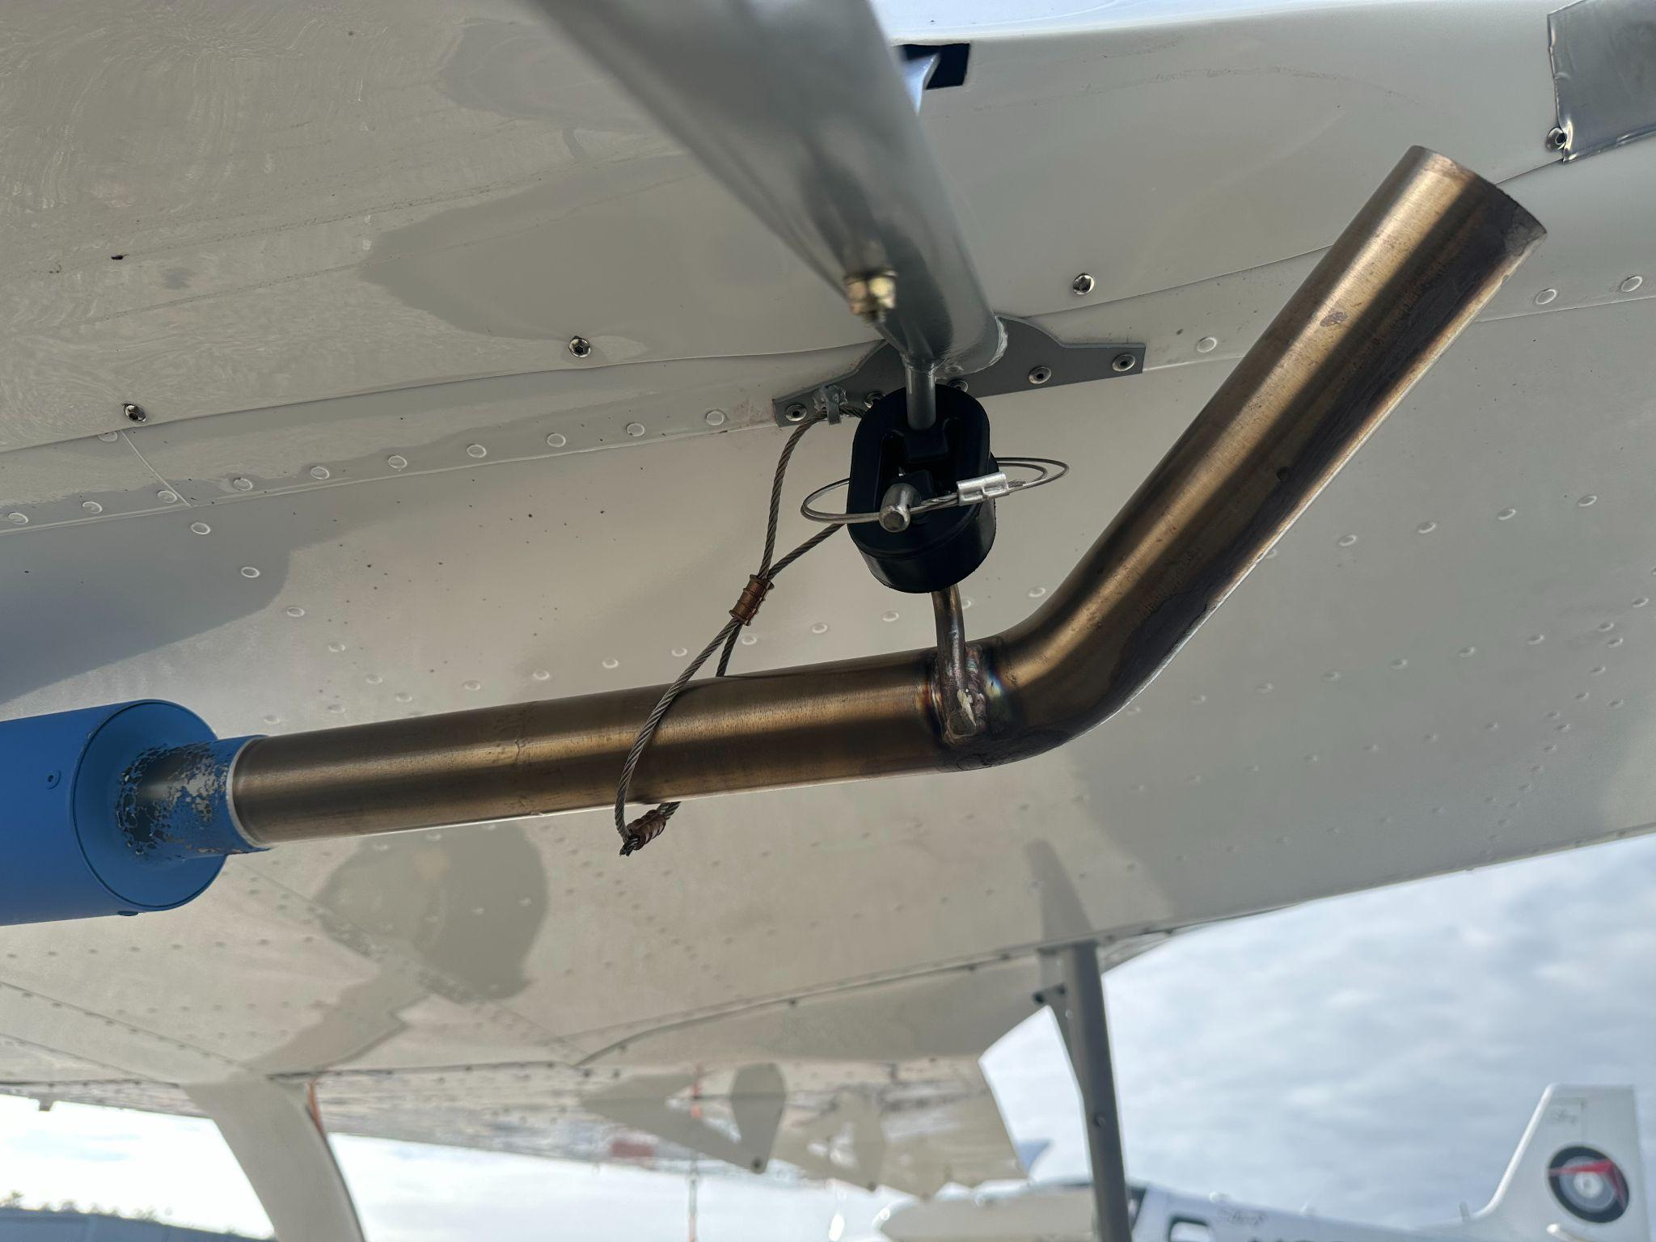
Acoustic Research & Development
Engine Exhaust Noise
SESSION THREE (Cont’d)
We iterated and tested a dozen versions of a “Swiss Muffler” Silencer.
Silencer is slung under the aircraft and has a ‘kick up’ behind the wing so that any residual sound is directed upwards, away from the communities below. RESULTS ARE SIGNIFICANT.

Slide 28
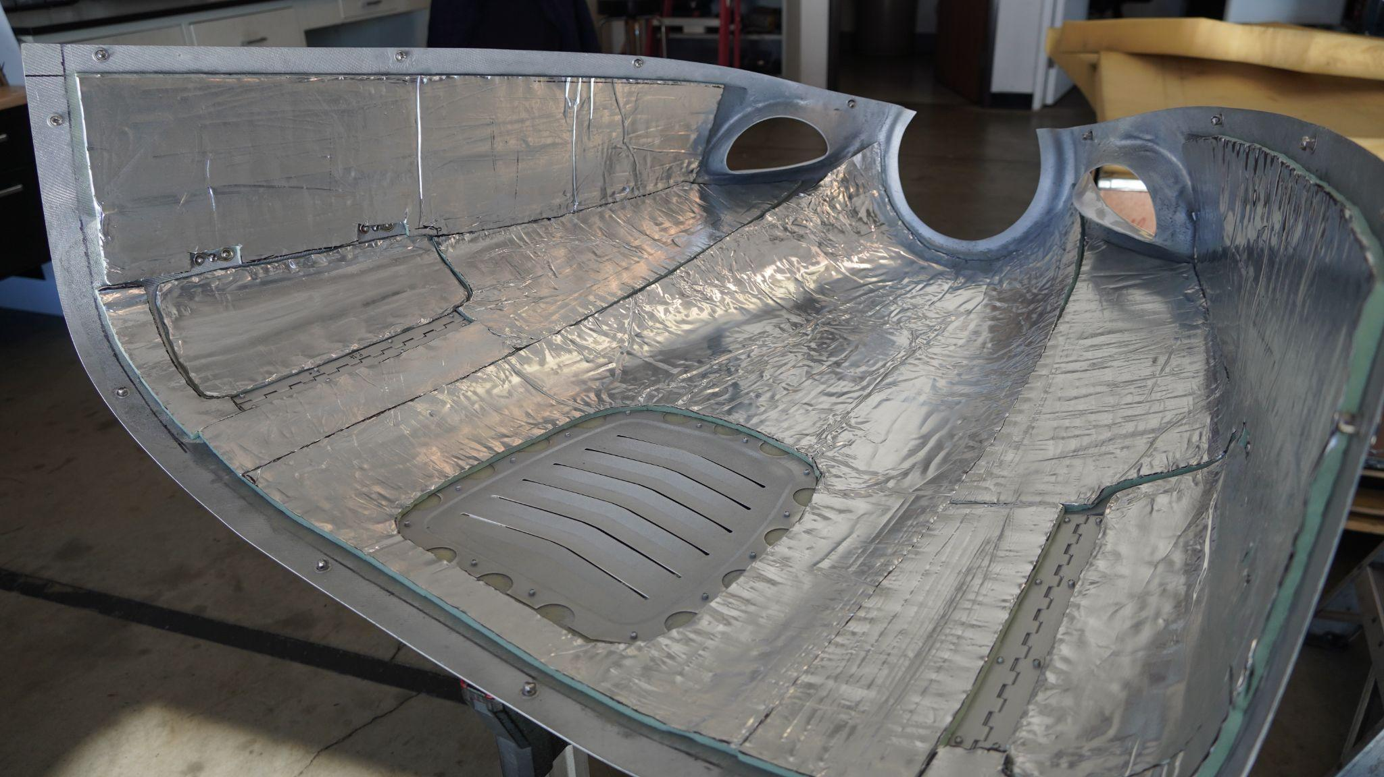
Acoustic Research & Development
Engine Compartment Noise
SESSION THREE (Cont’d)
Recognizing that the engine compartment is like a ‘resonance chamber’ for any noise produced by the engine itself vibrating, we lined the inside of the engine compartment with expensive acoustic damping foam. RESULTS ARE SIGNIFICANT.

Slide 29
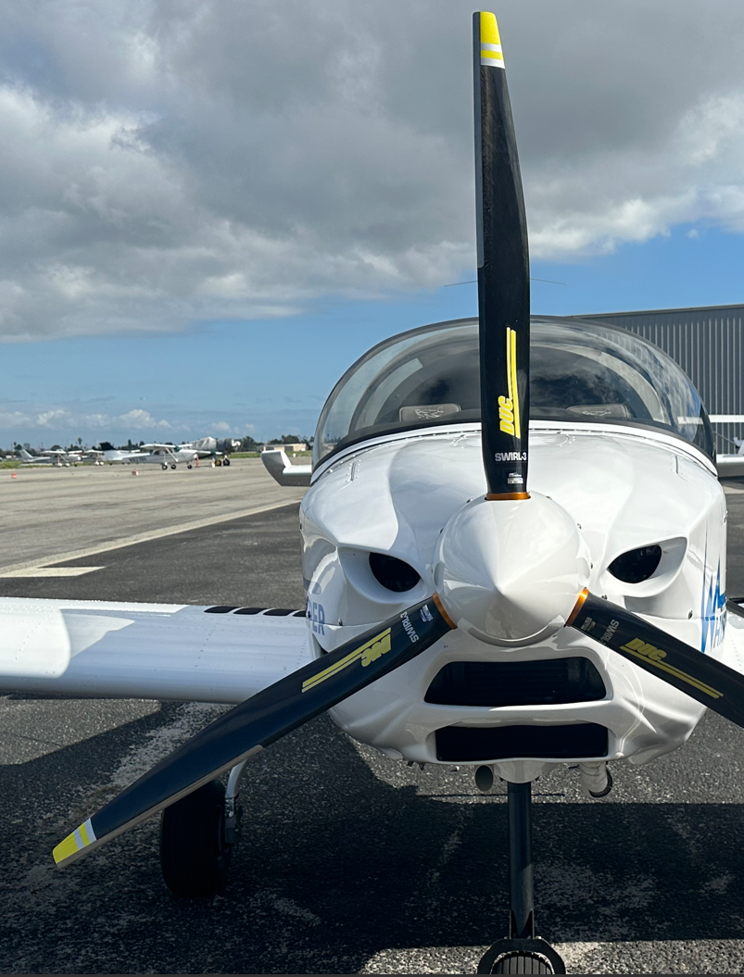
Acoustic Research & Development
Propeller Noise
SESSION THREE (Cont’d)
Propeller noise is caused by many elements of propeller design, including tip speed, which can be adjusted with diameter, tip thickness ratio, twist, shape, number of blades.
Less blades results in deeper pitch, but deeper pitched sounds travel further and through more materials.
We tested 8 propellers (2-bl/3-bl/4-bl) until we found the best combination of sound tone and quietness. RESULTS ARE SIGNIFICANT.
We have custom propeller in development to further decrease dB.

Slide 30
SESSION THREE (Cont’d)
Fly Quiet Programs: A Community Perspective
Tami Mulcahy | Sky Posse, Los Altos
Highlighted differences and best practices from a sample of airports (commercial and general aviation) as well as make recommendations for increasing the effectiveness of Fly Quiet Programs.
Interviews (7 airports) and online research
    Commercial Airports: DFW* LAX, LHR, SEA, SFO,
    General Aviation: Naples (APF), John Wayne (SNA**), Teterboro (TEB**)
Fly Quiet Program (FQP) Context
Voluntary programs because of Airport Noise and Capacity Act (1990)
  ANCA: no restrictions on noise or operations unless agreed to by FAA
  Grant assurances on Airport Improvement Program (AIP) funds also prevent airports from pursuing new restrictions
  Pre-ANCA grandfathered noise ordinances can be enforced by airports
  Multiple questions raised about restrictions
    Do ANCA and curfews apply to pistons, turboprops, and helicopters?
    Do curfews for touch-and-go operations and local operations affect interstate commerce?
FQP are voluntary and characteristics vary widely
  Airport type (Commercial vs GA) and airport resources
  Age of program
  Existence of pre-ANCA ordinances or not
  Airport specific environment, e.g. preferential runways

Slide 31
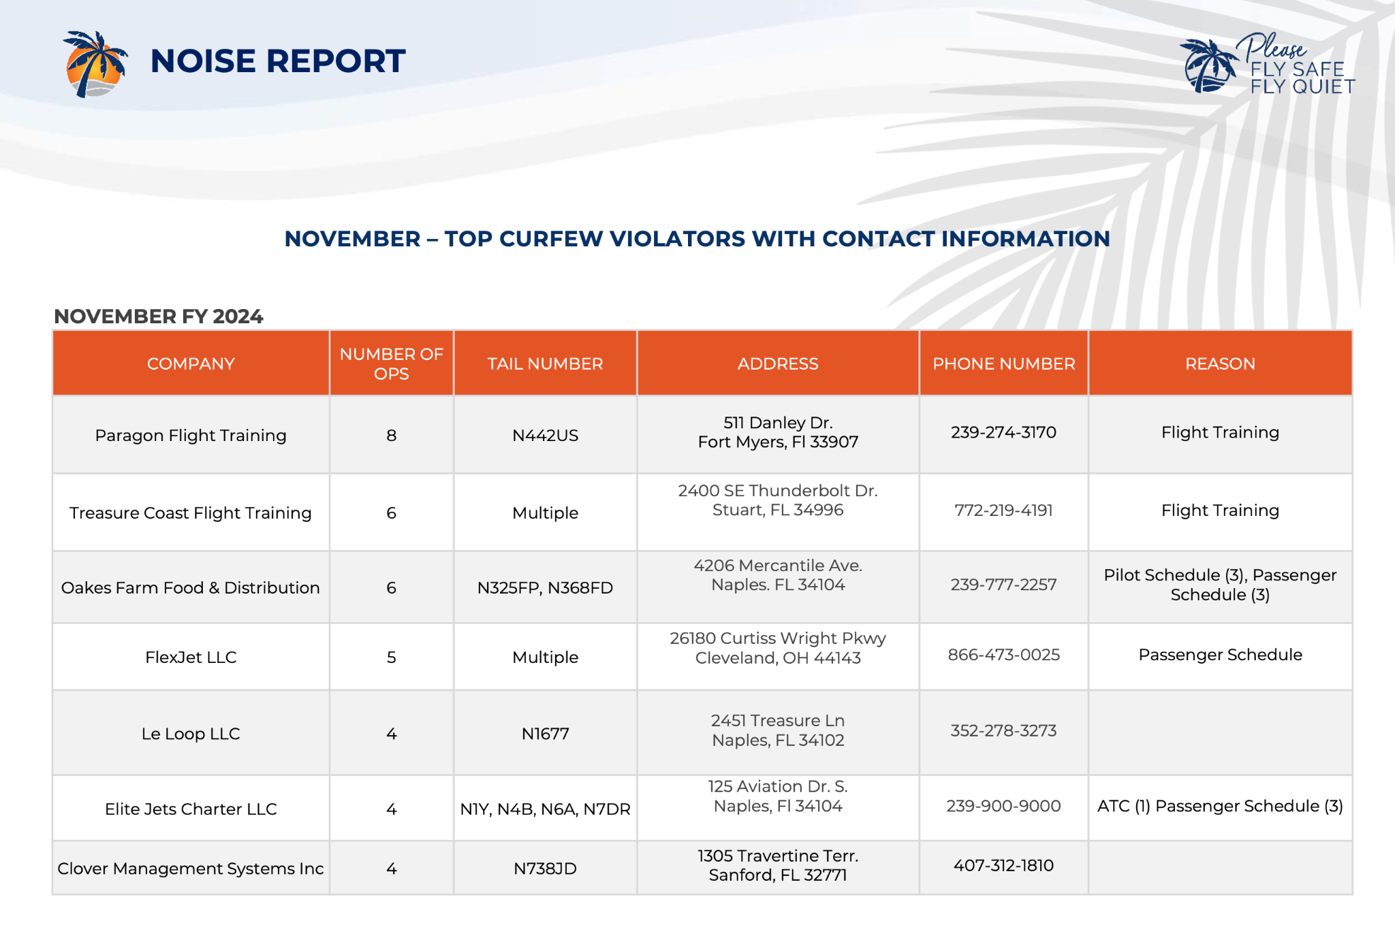
BEST PRACTICE:
APF Detailed and Transparent Reports, FQP Violations Follow-Up and Reasons
SESSION THREE (Cont’d)

Slide 32
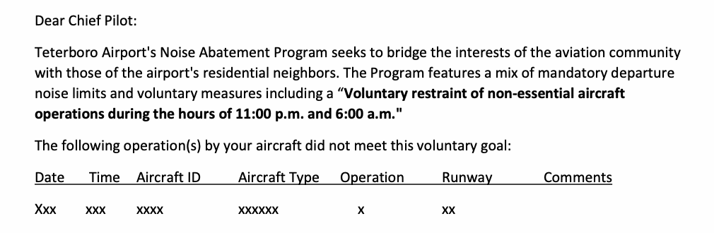
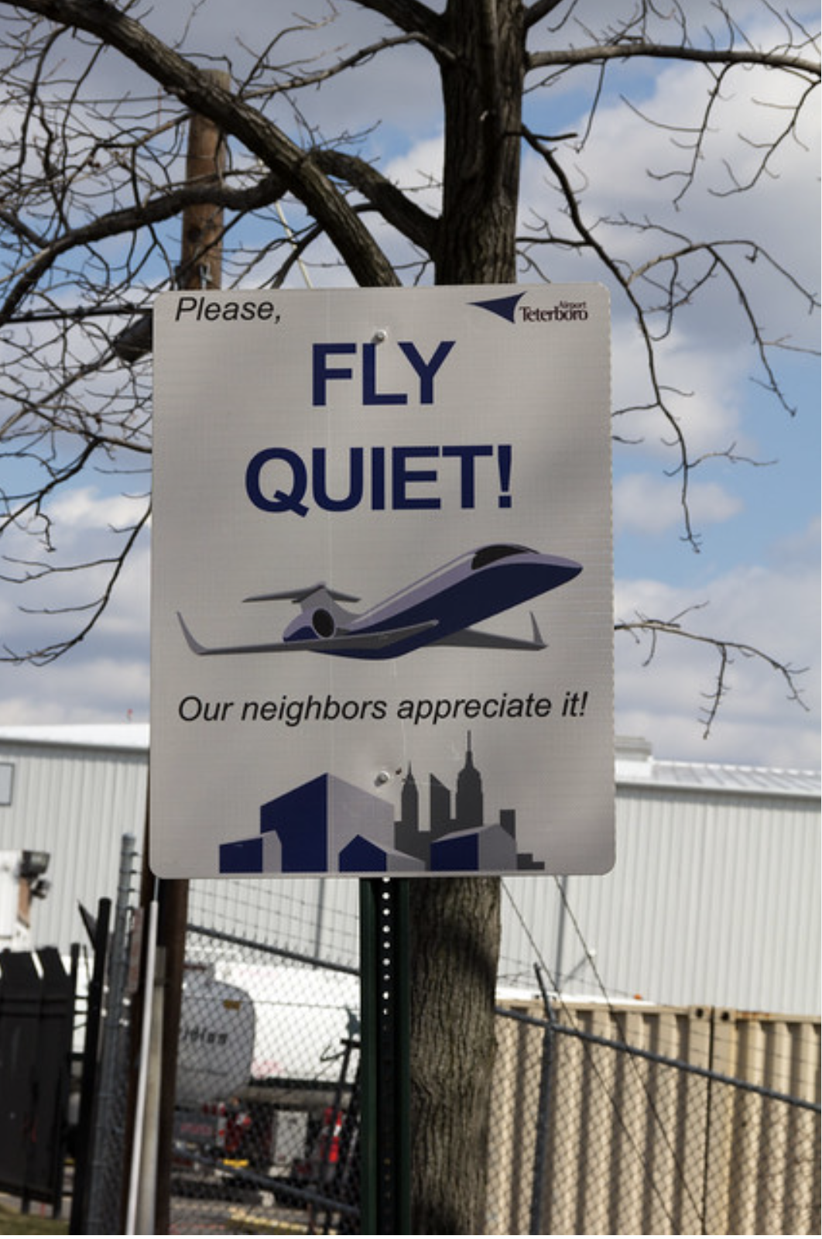
SESSION THREE (Cont’d)
Best Practice:
TEB Pilot Communication and Engagement, Award with Performance Bar
Face to Face, Individual Operators, and Teterboro User Group (TUG) Meetings
Mailing List of Pilots

Slide 33
SESSION THREE (Cont’d)
Best Practices: Summary Chart
 | GENERAL AVIATION AVIATION
Scoring | Bonus points for jet operator engagement (APF, SNA,) or for environment stewardship (SNA) Normalizing score of flight-related elements to # of operations (SNA)
Awards & Recognition | Ranking within a category (# of operations, aircraft type) (APF, SNA, TEB) All A-rated operators recognized (using A-F grading and top 3 scorers) (APF) Display on leaderboard in terminal (APF) All qualifying receive award – no violations for noise or voluntary nighttime curfew (TEB)
Reporting, Communication, and Outcomes | Distilled and accessible reports (SNA) Detailed and transparent reports (APF) Publish violation follow up and reasons (APF) Regular pilot/operator meetings (APF, TEB) Contact list for pilot/operators correspondence (APF, SNA, TEB) Quieter outcome example (APF)

Slide 34
Robust Community-Oriented FQP
SESSION THREE (Cont’d)
Replace Curve Ranking with a Minimum Performance Bar
Drive Improvement with Quantifiable Objectives Per Year and Means to Achieve Them
Balance Arrivals and Departures
Create Scorecard Per Airline/Tail# and Report Follow-Up Actions Taken
Balance between departures and arrivals and include elements that characterize or capture airframe noise far away from the airport (~10-20 miles) when pilots fly dirty on NextGen arrivals thus creating substantial noise
Bar is too low - winners even if no improvement YOY, graded on a curve and program resets every year
Set minimum performance requirements, not on a curve
Example:
Objective 1 - increase compliance of element by 5% vs previous year
Action 1: discuss with top violators how to increase compliance and gain commitment to change their current practice
For total score and per element: show historical trends (last 5 years), grading relative to min performance targets, ranking relative to peers, follow-up actions & responses
Separate Airline/Pilot and FAA/ATC controlled elements

Slide 35
Robust Community-Oriented FQP Cont.
SESSION THREE (Cont’d)
Strengthen Award Categories to Reflect Noise Reduction
Include Affected Communities as an Equal Stakeholder and Reflect Community Impacts
Add Emissions in the Program Elements
Standardization Key Parts of FQP
“Most Outstanding” for Sustained Performance ⩾5 years
  Overall and for each element
Performance per Year
  ”Best Overall”
  “Most Improved”, overall and for each element
    ”Best in Class” for each element
Communicating the final program to community is not collaboration
Elements & criteria need to reflect community impacts
Examples:
Commercial: emissions metrics of Nitrogen Oxide emissions per seat (CAEP standard)
GA: leaded fuel and unleaded fuel sales. When operations are predominately jets, then use Commercial metrics
Examples:
Use DNL nighttime hours (10pm-7am)
Always balance Quiet Fleet w/equivalent element for airframe noise
Normalize raw scores to # ops as applicable
Systematic reports & follow up on compliance
Use Community-Oriented FQP Checklist

Slide 36
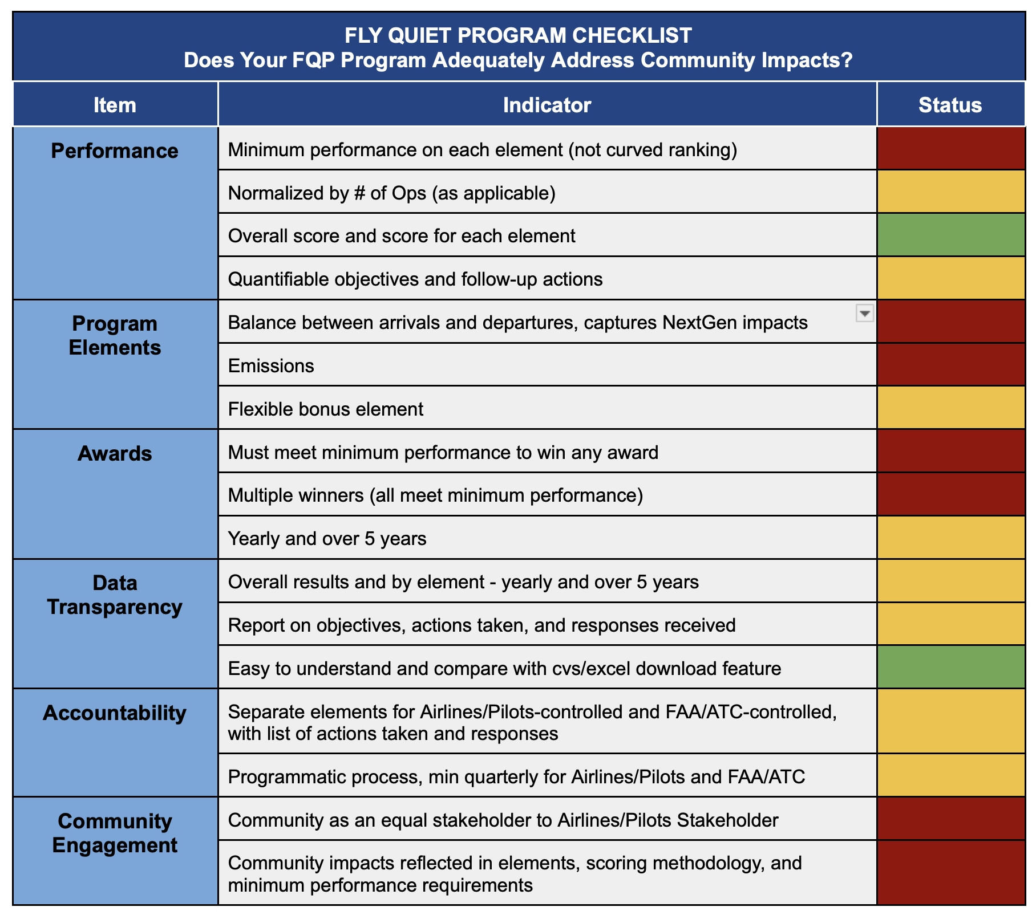
Does Your FQP Adequately Address Community Impacts?
SESSION THREE (Cont’d)

Slide 37
SESSION FOUR
Perspectives on Environmental Impacts and Environmental Justice
Environmental justice is a critical part of the framing for sustainable aviation.
Environmental Justice in Airport Planning Practice – Amber McNair, Ohio State University
  Described how the FAA and airport owners framed and evaluated environmental justice in the NEPA planning process for airport expansion projects. Discussed emerging environmental and US Airport planning topics.
Perspectives on the Environmental Justice Journey in Aviation’s Purview – Sabrina Johnson & Tai Lung, US EPA
  Environmental protection for all requires collective action. Described current challenges and provided perspectives on priorities Environmental Justice and Equity commitments. Featured a demo of EJScreen, EPA’s Environmental Justice Screening & Mapping Tool.
FAA Perspectives on Environmental Impacts and Environmental Justice – Don Scata, FAA
https://anesymposium.aqrc.ucdavis.edu/2024-program-information#EnvironmentalImpacts

Slide 38
SESSION FIVE
Conquering Regional Air Transportation with a Reduced Noise Footprint (AAM)
An Overview of NASA Research on AAM Noise and a Recent Noise and Number Study
  Aaron Vaughn, NASA Langley Research Center
    NASA conducts psychoacoustic research on the human response to Urban Air Mobility (UAM) vehicles as part of its Advanced Air Mobility (AAM) mission.
    This presentation provides an overview of NASA’s role in AAM research with an emphasis on recent work investigating people’s response to frequent UAM vehicle flyover sounds.
FBO Infrastructure: Preparing for Electric Aviation
  Scott Cutshall, Clay Lacy Aviation
Investigating & Guiding Outcomes for Advances Air Mobility (AAM)
  Matt Friedman, CalTrans
https://anesymposium.aqrc.ucdavis.edu/2024-program-information#AAM

Slide 39
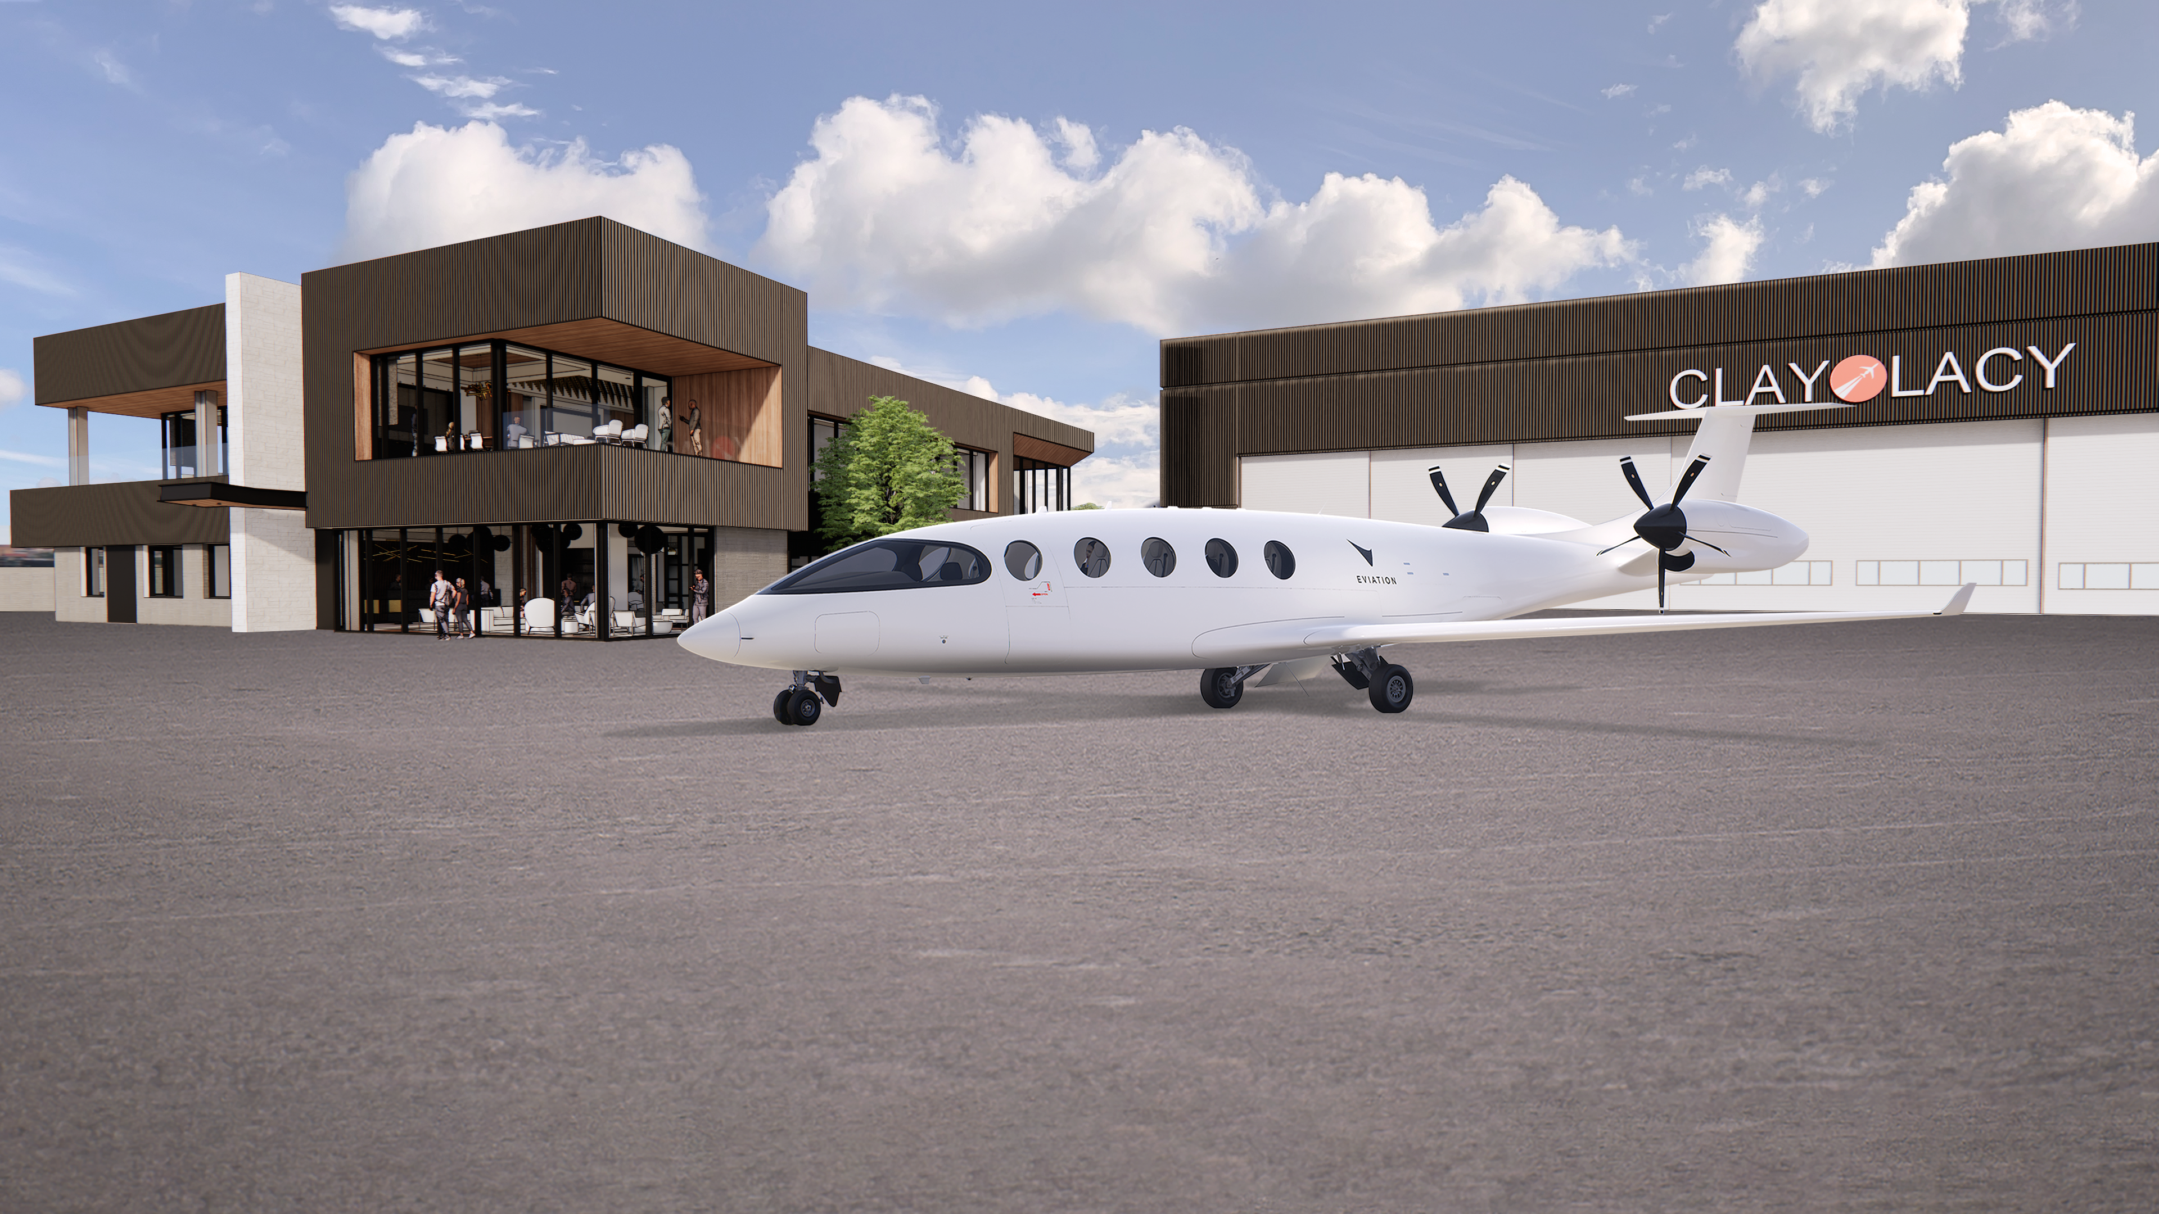
FBO & AIRPORT INFRASTRUCTURE
PREPARING FOR ELECTRIC AVIATION
SESSION FIVE (Cont’d)
Clay Lacy Aviation | Scott Cutshall – John Wayne Airport
Clay Lacy is primarily and aircraft management company, managing a 160 private aircraft. About half of the airplanes are available for charter.
They have 2 FBOs, VNY and John Wayne Airport and opening their third in Connecticut (2 hour drive from Park City) in Summer 2024.
The perspectives come from his experience with talking with a variety of eVTOL manufacturers and a group they are working with in constructing their new FBO at John Wayne Airport. And through these conversations, they have planed for and are preparing to begin installing charging infrastructure for electric aircraft.
Clay Lacy is planning now with utility providers and permitting with their airports to prepare for Electric Aviation.

Slide 40
TIMELINE
SESSION FIVE (Cont’d)
Proof of Concept
NEAR TERM (next 10 years)
MID TERM
LONG TERM
Airports
Launch Markets
Community Engagement
COST
Dedicated Vertiports
Secondary Markets
Transport Hub Integration
SCALE
MOVEMENTS
TODAY
FUTURE

Slide 41
TIMELINE CONT.
SESSION FIVE (Cont’d)
NEAR TERM (Next 10 years)
  Proof of Concept - still do not have a certified eVOTL aircraft today.
  Airports - Operations will start at airports – these will be certified as GA aircraft.
    They will start at private terminals, The FBOs. These are mostly private companies (non governmental). They can move a little quicker in getting the infrastructure put in. They also have lease obligations and commitments to improve their property over the course of their lease. And knowing that this new generation of aircraft is coming, it’s a logical next step.
  Launch Markets – What Airports. The OEMs have started to announce: SoCal, Dallas Fort Worth, Houston, New York City and Miami seem to be the ones that several EVOTLs are mentioning on a regular basis
  Community Engagement – This is going to be key in the start of operations. There are more questions than answers today. The OEMs and operators like Clay Lacy need to have regular frequent conversation with the local communities and elected officials and with the airports about what this will look like in the near term.
MID-TERM - Dedicated Vertiports / Secondary Markets
LONG-TERM
  Transport Hub Integration / LANDING & PARKING
  Vertaports or landing areas co-located in transportation hubs (this could be co-located with a commercial airline terminal, rail, or other modes of transportation)

Slide 42
CHARGING INFRATRUCTURE | NEAR TERM
SESSION FIVE (Cont’d)
POWER
480V, 3-phase, 60Hz power / ~600 kVA at peak / 1000A main breaker
This is what is needed to charge ONE aircraft
Clay Lacy is planning on double this at John Wayne Airport
Ex. Take 15 minutes, then fly 30 miles and then land and charge 50 minutes…then fly 30 miles. They can fly further than 30 miles but they see this is the optimal stage length.
FIXED VS. MOBILE - Fixed (bringing aircraft to the charging station) vs Mobile (bringing charging to the aircraft)
FUNDING
Private - Clay Lacy is funding this at John Wayne Airport.
Grants
  None available that Clay Lacy knows of to date.
  It’s new. It hasn’t been contemplated yet. They are focusing on electrifying buses etc.
Other
  Funding is a real challenge to scale given the costs involved in bringing power onto the property
  Ex. In OC, they are looking at about $800,000 to bring in 2 charging pads. Key note: Putting this in without a certified airplane to actually use it that they can make money back to pay for it. But they see this an investment in the industry’s future.

Slide 43
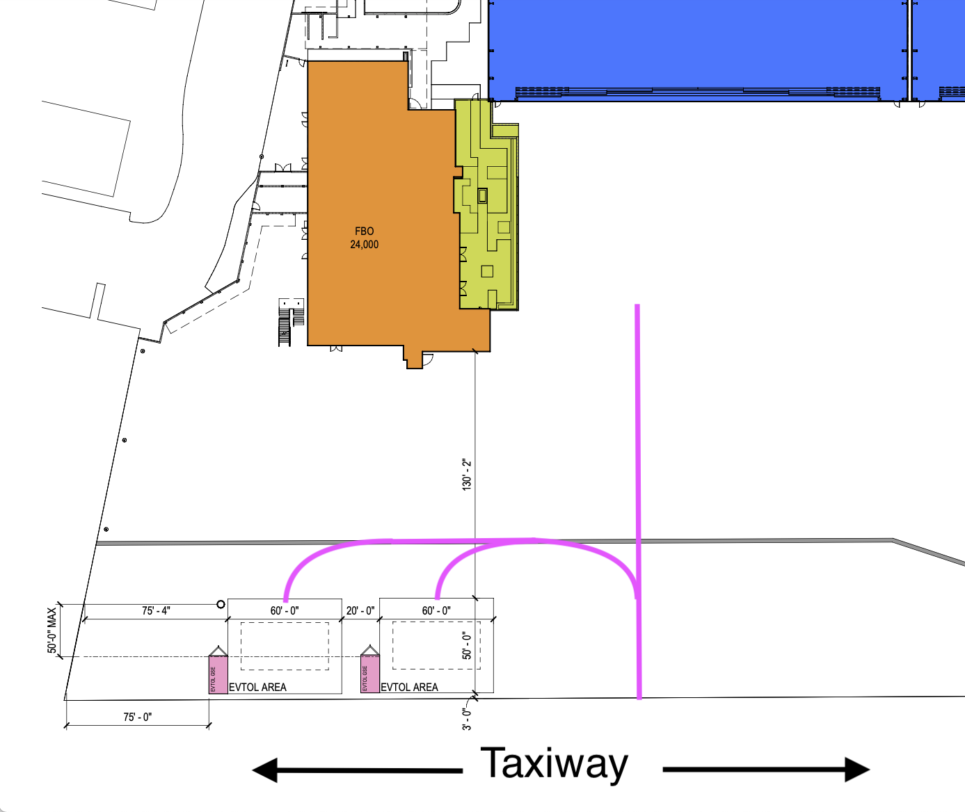
LANDING & PARKING| NEAR TERM
SESSION FIVE (Cont’d)
Passenger Terminal
Outdoor Patio
CONSIDERATIONS
  Traffic pattern
  Ground taxi considerations
  Proximities to terminal and taxiways
  Obstacle free ramps
  Passenger flow
Evotl Parking
Charging Units (Pink)

Slide 44
LANDING & PARKING| NEAR TERM CONT.
SESSION FIVE (Cont’d)
CONSIDERATIONS Cont.
Proximities to terminal and taxiways (pink line taxi line) / Passenger Flow
  Currently when a plane lands at a FBO, it could be there for days/weeks.
  These are intended to be high frequency operations. These are intended to come and go every 15 minutes so they needed to be in a location with easy access have to the taxiway.
    They also need to be in close proximity of passenger terminal because you don’t want passengers coming every 15 minutes walking through airplanes and propellers to get back & for the. But also not too close (past spinning blades).
NOTE: Scott met with Wisk Feb/March 2024. Wisk’s eVOTL is planned to be autonomous (no pilot) and there is no gear so it doesn’t taxi. So the landing/parking design Clay Lacy came up with wouldn’t work for Whist…but he believes they came up with a plan that will work.

Slide 45
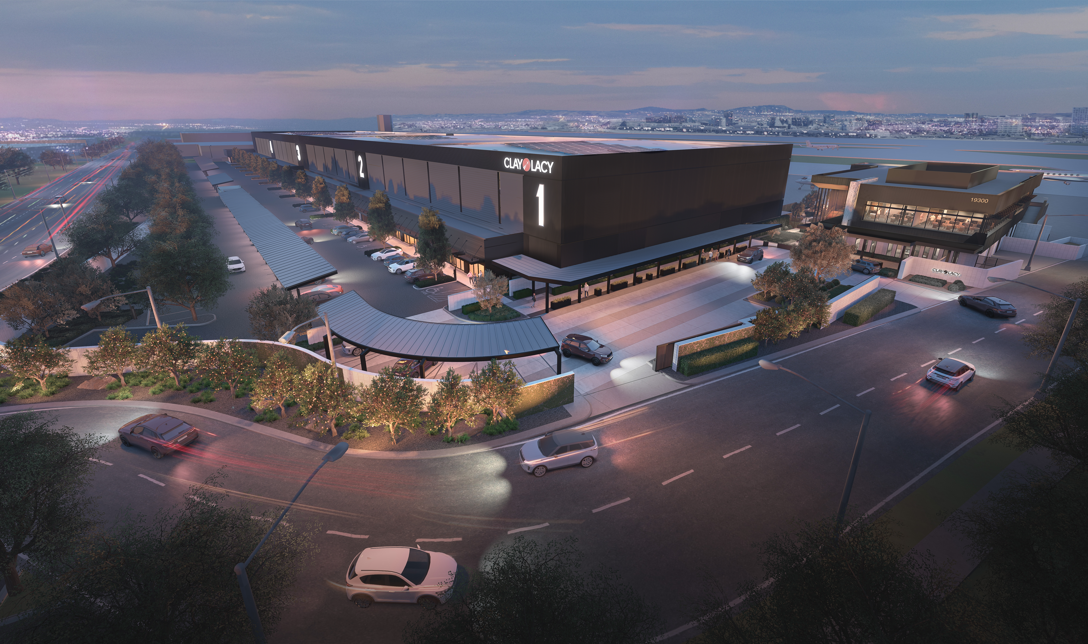
SESSION FIVE (Cont’d)
Starting construction on new location/FBO at John Wayne Airport (pictured below) – Hoping to start in the next 30-40 days.

Slide 46
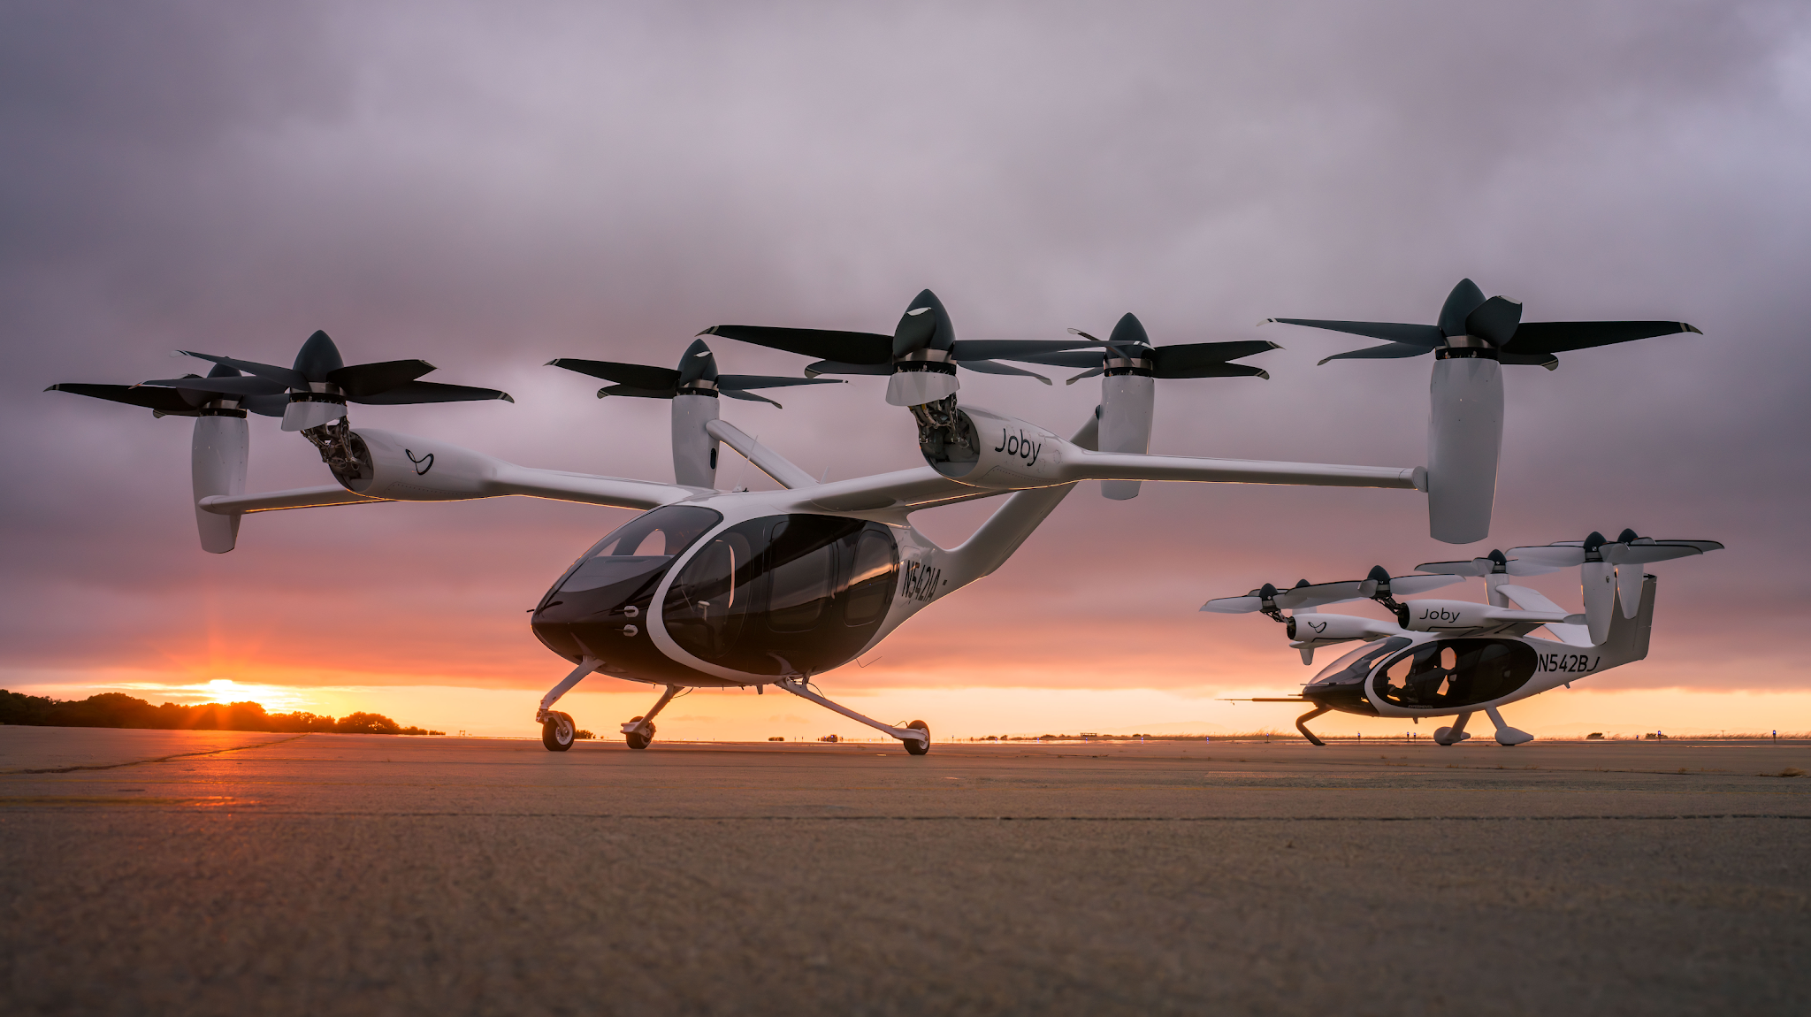
Investigating & Guiding Outcomes for Advanced Air Mobility (AAM)
Matt Friedman, Caltrans Aeronautics Program
SESSION FIVE (Cont’d)
Advanced Air Mobility (AAM)
  AAM is a new concept of air transportation using electric vertical takeoff and landing (eVTOL) aircraft to move people and cargo between places not currently or easily served by surface transportation or existing aviation modes. EVTOL aircraft may be powered by hybrid electric systems, batteries or potentially hydrogen fuel cells. (National Business Aviation Association)
Terms & Acronyms
UAM - Urban Air Mobility
RAM – Regional air mobility
UAS – Unscrewed aircraft system
VERTIPORT - Take and landing location for EVTOLs
Photo by Joby Aviation

Slide 47
SESSION FIVE (Cont’d)
Topics and needs are interacting with each other in new ways. For example local land use planning will play a major role in placement of vertiports.
Revolution: The changes are happening rapidly.
Policy: Existing policy and guidance is not keeping up with the technology changes.
  For example, the California Airport Land Use Planning Handbook, currently under revision, broadly describes the 65dB noise threshold in California, but does not consider advancement in sound measurement or understanding of noise impacts on individuals and communities.
AAM in the Transportation System
Maximize existing uses, such as General Aviation Airports
Positive elements: Access to and from rural, disadvantaged or underserved communities, electrification
Negative elements: Increased noise, visual clutter, air quality degradation, surface congestion
Placement of Vertiports
Placement of vertiports is new territory for local land use authorities
Land use issues have many additional and complex layers
Importance of early consultation between stakeholders

Slide 48
SESSION SIX
Innovative Strategies for Quantifying and Communicating Aviation Noise Impacts
Approaches of Flight Procedure Noise Modeling of Commercial Aircraft
  Jacqueline Huynh, University of California, Irvine
A Tactical Approach to Mitigating Aircraft Noise Through Collaboration and Use of Noise Metric Models
  Mel Beale, Airport Working Group of Orange County
Representing Aircraft Noise Impacts – A Community Perspective
  Marie-Jo Fremont, Concerned Residents of Palo Alto, California
https://anesymposium.aqrc.ucdavis.edu/2024-program-information#NoiseImpacts

Slide 49
A Tactical Approach to Mitigating Aircraft Noise Through Collaboration and Use of New Noise Metrics
SESSION SIX (Cont’d)
Presenter- Mel Beale, Airport Working Group of Orange County
OBJECTIVE:
To present a path toward the acceptance of technically viable alternative noise metrics more fair to the entire stakeholder community through tactical and comprehensive analysis models leveraging our work done for a typical single commercial airport and Support adoption of alternative metric models
CLOSING MESSAGE
65DNL is widely unpopular and has yielded little protection to communities at large
FAA has opened the door to innovative approaches to provide balance to future Part 150 expansions or flight procedure changes like NEXGEN

Slide 50
SESSION SIX (Cont’d)
Premise(s) of current deficiency of 65DNL and proposed alterative
  65DNL time span (24 hours / 365 days) is not a valid time span model to use to measure community impact from aircraft noise
  65DNL is not a balanced approach (18 page response to FAA)
  A proposed set of continuous smaller time window segments would be more appropriate measures of noise intensity impact
    For example- the 1st 4 hour period of heavy departure traffic at any high volume commercial airport, USA, and each 4 hour segment thereafter over the 24 hour day.
    Each 4 hour segment could have a new control noise limit metric with math models generated similar to the 65DNL algorithm
    New airport baselines could be set in 20XX. Any new projects (Part 150 requirements) or programs (i.e., like NEXGEN) would be controlled by whether it negatively influenced the derived 4 hour metrics at that airport.

Slide 51
Representing Aircraft Noise Impacts
A Community Perspective
Marie-Jo Fremont - Co-founder, Concerned Residents of Palo Alto, CA
SESSION SIX (Cont’d)
Problem statement - DNL does not accurately reflect the lived experience of communities impacted by aircraft noise
The presentation is regarding COMMERCIAL airports but the observations are relevant to GA airports as well
Research on what some airports do today
    Noise data collection and analysis
    Noise Metrics
    Community access to noise data
Interview 6 commercial airports and online research
  Small sample of commercial airports (DFW, JWA/SNA, LAX, MSP, SEA, SFO)
This method can go into effect at airports immediately. They already have all of the date. She implored Community Groups/Roundtables (ex. CAC) to request this of their airports ASAP

Slide 52
Takeaways on current representation of noise impacts
SESSION SIX (Cont’d)
Airports have great capabilities for data collection, analysis, and reporting
DNL65-centric representation, not community-centric
  Aligned with FAA policies and reporting requirements
  Airports, with existing tools, can report other noise metrics
  Airports have full discretion on how to report noise impacts
Limited value of data
  Imbalanced noise monitor coverage for NextGen environment (concentrated flight paths, need multiple monitors 10-20 miles from airport)
  If ANEEM is not used underestimation of noise impacts
  Detailed data not published (ex. Daytime, flight #, altitude, etc.)

Slide 53
How do communities experience aircraft noise?
SESSION SIX (Cont’d)
Loudness of each event relative to ambient noise. People perceive sound based on the ambient noise. Fictitious noise event below. The more the community noise, the higher the ambient noise.
Key factors in aircraft noise experience
  How loud - Relative to ambient noise
  How many - All air vehicles. All aviation noise should be accounted.
    Airplanes, helicopters, military jets, drones, space launches
    To/from multiple locations (all airports, helipads, launch pads)
    Commercial (passengers & cargo), General Aviation, and Military
  When - Time of occurrence penalties for nighttime
  How frequent - Penalties for cadence/frequency

Slide 54
N-Above-Ambient: a community-centric metric
SESSION SIX (Cont’d)
N-Above-Ambient (NAA) captures 4 key factors
# aircraft with Lmax above ambient: how loud, how many
  Similar to N-Above
  FAA statement¹: N-Above good predictor of annoyance
Penalties on Lmax of each noise event (like DNL/CNEL penalties)
  Time of occurrence: when
  Cadence: how frequent
    During “rush hours” and during nighttime
    Examples for illustration only
      Rush Hour: 5 dB extra penalty on each aircraft in periods with >=12 aircraft/hour
      Nighttime: 10 dB extra penalty for aircraft that flew within 15 minutes
¹Source: page 107 of Noise Around Airports: A Global Perspective report from November 2022 https://www.inceusa.org/pub/

Slide 55
Why use TNI instead of DNL
SESSION SIX (Cont’d)
More accurate representation of community impacts than DNL
Reflects the lived experience of communities
  How loud, how many, when, how frequent
  All overflight impacts near airport and away from airport
    All air vehicles, to and from all locations
    More details in Noise Policy Review comment ID FAA-2023-0855-2265
Straightforward calculation
  3 variables: Lmax, Ambient, Penalties

Slide 56
Acronyms and definitions
SESSION SIX (Cont’d)
AEDT: Aviation Environmental Design Tool
Airport Codes:
  DFW: Dallas Fort Worth International Airport
  JWA: John Wayne Airport (FAA code: SNA)
  LAX: Los Angeles International Airport
  MSP: Minneapolis-Saint Paul International Airport
  SEA: Seattle-Tacoma International Airport
  SFO: San Francisco International Airport
ANEEM: Aircraft Noise Event Extraction Methodology
CNEL: same as DNL except for an additional 5 dB penalty for evening hours (7pm-10pm)
DNL: Day Night Average Sound Level (DNL or Ldn). Cumulative noise exposure over 24-hour period. 10 dB penalty for night hours (10pm-7am)
Lmax: Maximum sound level during a single noise event.
N-Above: Number of noise events that exceed a certain noise level.
NEPA: National Environmental Policy Act
SEL: Sound Exposure Level. Acoustic energy of a noise event as if the event had occurred within one second.

Slide 57
SESSION SEVEN
Climate Change & Aviation
Airlines’ “All of the Above” Approach to Decarbonization
  Kenley Farmer, Airlines for America
    Ongoing efforts to further reduce carbon emissions and other environmental impacts associated with aviation, including U.S. carriers' commitment to achieve net-zero carbon emissions by 2050, implementation of more efficient procedures (in-flight and ground), and addressing non-CO2 impacts.
How AI Can Accelerate Climate Positive Action
  Dinesh Sanekommu, Google
    Understanding contrail-cirrus through satellite imagery, ADS-B, meteorology, and more. AI can accelerate our understanding and eventual mitigation of contrail-cirrus.
Enhancing Aviation Environmental Performance Through Improved Decision Making
  Ted Thrasher, The MITRE Corporation
    Aviation activity contributes to Earth’s warming through emissions of carbon dioxide (CO2), black carbon (BC), and the formation of persistent warming contrails. MITRE is developing an integrated method that allows aircraft operators to understand the combined climate effect of their operations alongside operating costs and schedule to more rapidly.
Sustainability Framework and NAV CANADA - Jonathan Bagg, NAV CANADA
https://anesymposium.aqrc.ucdavis.edu/2024-program-information#ClimateChange

Slide 58
SESSION EIGHT
Measuring and Modeling Air Quality Emissions
Monitoring Airport Emissions - Maggie Isied, Clarity Movement
  Air quality measurement includes a variety of technologies and methods and provides a means to empower the community and industry to achieve healthier communities and improved operations with data. Factors presented to consider when using low-cost sensor technology and the pros and cons of using this monitoring technique to evaluate airport emissions.
Decoding Airport Emissions: Analysis Using the Aviation Environmental Design Tool (AEDT)
  Gwen Pelletier, CDM Smith
    Analysis Using the Aviation Environmental Design Tool (AEDT) – can provide a comprehensive view of emissions from all parts of an airplane’s journey and airport-based activities. FAA’s required method for evaluating the air quality impacts of aviation, such as by estimating criteria air pollutant and GHG emissions and dispersed pollutant concentrations.
Community Measurements of Aviation-related Ambient Air Quality
  Kevin Lane, Boston University School of Public Health (Ultrafine Particle Research)
    In this study they monitored and modeled UFP using stationary and monitoring to conduct source attribution to quantify inflight and ground-based aviation-related contributions to ambient air quality.
https://anesymposium.aqrc.ucdavis.edu/2024-program-information#AQEmissions

Slide 59
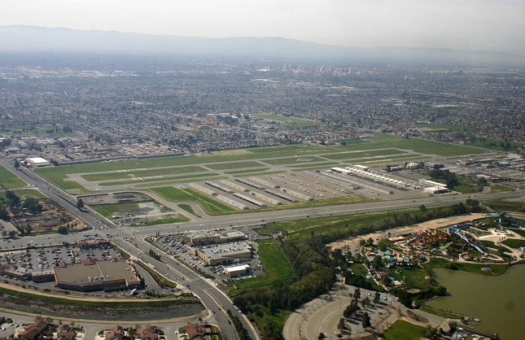
SESSION NINE/ KEYNOTE SPEAKER
Leaded Aviation Gasoline Exposure Risk in San Jose, CA​
Cindy Chavez, Santa Clara County Board of Supervisors, District 2 Representative
San Jose – District 2 – Santa Clara​ - Most tightly packed and urbanized of the 5 districts​
Reid-Hillview Airport (1 of 2 airports in area)​ - 1937: Opened for private use​
General Aviation Airport - approx. 200 acres​
Small aircraft only. Training for amateur pilots​
https://anesymposium.aqrc.ucdavis.edu/2024-program-information#Keynote

Slide 60
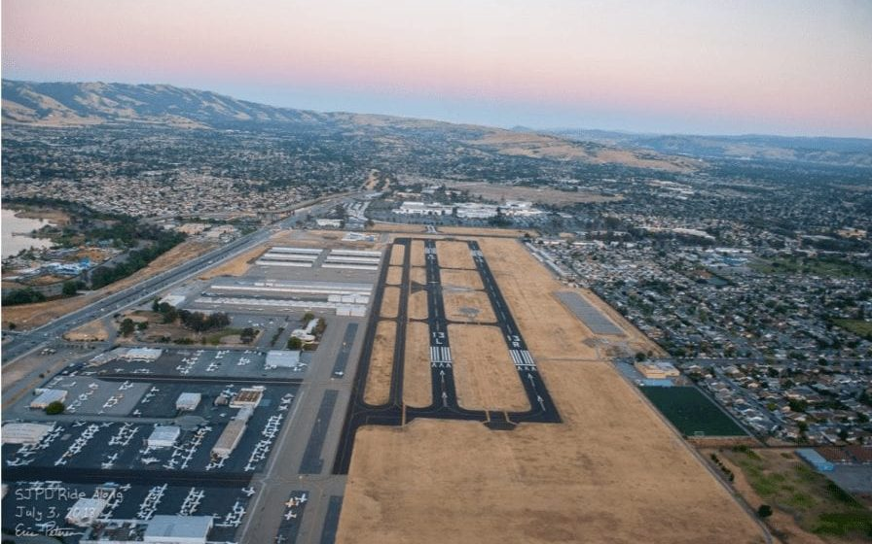

Concerns from residents
SESSION NINE (Cont’d)
Surrounded by neighborhood, single-family homes, apartments/condos
Demand for alternative uses such as mixed-use development, education, recreation, community assets, and transit-oriented development
Incompatible land use
Common resident complaints:
Noise
Emissions
Fear of crashes
2018: Action Taken by Santa Clara County
Affirmed County’s 2011 decision to not take FAA airport improvement grants
Airport closure by 2031
Undertake land use study for post-aviation future use
Study health impacts of emissions from lead-fueled aviation
Link: December 2018 meeting report

Slide 61
Why a lead study?
SESSION NINE (Cont’d)
Center for Disease Control: “There’s no safe level of lead in blood”
A 2008 US EPA ranked RHV 25th out of 3,414 US airports with an estimated 1,279 pounds of lead emitted annually
In 2020, the US EPA reported that RHV is one of the few US airports where lead emissions from piston aircraft exceed National Ambient Air Quality Standard (NAAQS) for lead
County lead study was a tool to affirm prior EPA studies and public concerns
Lead exposure causes neurological damage to infants and children and stunts IQ. Lead causes high blood pressure and heart disease in adults
Thousands of children live and go to school or play next door to RHV
THE LEAD STUDY
Commissioned by the County of Santa Clara
Led by Dr. Sammy Zahran and the Mountain Data Group – Link: Dr. Zahran Bio
Comprehensive and controlled study reviewed 10 years of data
Studied the blood levels of 13,000 children
Controlled for non-aviation lead (paint, old pipes, etc.)
Peer reviewed
Study released August 2021
Presented to the Santa Clara County Board of Supervisors days later
Link: Airborne Lead Study

Slide 62

Lead study: Released August 3, 2021
SESSION NINE (Cont’d)
Key finding: The continued use of leaded aviation fuel has contributed to increased blood lead levels, particularly for those within a half-mile of the airport.
Link: Fulll Study PDF

Slide 63
Lead Study Findings
SESSION NINE (Cont’d)
BLLs of samples children increase significantly with proximity to the airport
BLLs of sampled children increase significantly with aircraft traffic at airport and monthly quantities of aviation gasoline sold from the date of blood draw
Children who live within a half-mile of the airport had blood lead levels 20% higher than children living between half-mile to 1.5 miles from the airport
Action Taken on Aug. 17, 2021
Accepted the study
Immediately take all available actions to prevent continued lead exposure from Reid-Hillview
Update County Health Assessments to include study
Community engagement
County lead screening and prevention activities
Placed study in peer-reviewed scientific journal
County Counsel submits petition to EPA for endangerment finding
Secure unleaded avgas for County-owned airports
Phase out unleaded avgas by Dec. 31, 2021
Link - August 17 meeting report

Slide 64
Switch to unleaded avgas
SESSION NINE (Cont’d)
Direction from Board after lead study findings
2 manufacturers of unleaded Avgas
  1. Swift
  2) Gami (going into production 3/2024)
On 1/1/22, County took over fuel supply at both County airports. County now offers exclusively unleaded fuel
Santa Clara County took over the leases where the fuel tanks are, so transition was pretty smooth and not very expensive. Just put new fuel in tanks – fuel is interchangeable. ​
Reid-Hillview is selling same amount of unleaded gas as they did leaded.
Planes can still fly in with leaded avgas but must refill elsewhere.
What comes next?
Momentum is building
The bodies that own & operate the airport should be working with communities to move towards unleaded avgas.
Increased interest from other jurisdictions
  Senator Caroline Menjivar
  Introduced Senate Bill 1193 – Banning the sale of Leaded Aviation Fuel (urban areas by 1/1/2028 / California by 1/1/2030)

Slide 65
SESSION TEN/KEYNOTE SPEAKER
Working Together on Land Use Compatibility​
Peter Kirsch, Kaplan Kirsch & Rockwell
How DNL and 65 dB were selected – How we came to use 65 db & DNL metric.
  Noise Control Act of 1972
    Directed EPA to select cumulative noise metric
    Publish “levels of…noise…requisite to protect public health and welfare with adequate margin of safety”
    It’s important to remember the language that’s in the statute – it was directed to do a balancing – a balancing between noise, public health and safety
    It was not supposed to be an absolute measure of noise but a measure and a metric and a threshold that was designed to appease these balances.
  Technical studies that resulted from the Noise Control Act are now referred to the 1974 EPA “Levels Document”
  FAA Noise Policy 1976 – the last finalized policy the FAA has issued
    Sought to achieve a balance between ”desirable and technical and financially achievable” measures to address noise
    The reason this is important is because we need to understand the balancing was done in the context of the 1970s. That was what was desirable and technical and financially achievable in the 1970s. And in fact, might be different today. The balancing to achieve back then is very different from the balancing today.
https://anesymposium.aqrc.ucdavis.edu/2024-program-information#Keynote
Presentation Recording: https://youtu.be/MKorFV4U3h4?si=RsTpFbK1A4tJ_5pP

Slide 66
More History
SESSION TEN (Cont’d)
Aviation Safety and Noise Abatement Act of 1979 (ASNA)
  Establish single system of noise measurement – ASNA did not direct the use of a single metric, it did not direct the use of the single threshold of land use compatibility. It merely directed a system of noise measurement.
  The statute that established the Part 150 Program
  Identify land uses normally compatible with various noise exposures. This was not intended to be used as a federal standard requirement with land use compatibility with communities.
Part 150 (1980)
Airport Noise and Capacity Act and Part 161 (1990)
FAA Proposed Noise Policy (2000)
ASNA and Part 150 were established for one purpose for the reporting of noise and planning for noise compatibility. Whereas the principles that were established have over the course of the last 50 years been applied out of context where they were clearly never intended in the original statute.

Slide 67
Important distinctions
SESSION TEN (Cont’d)
Regulation of noise at is source (set forth in Part 36 of FAA regulations) – this has to do with the noise generated by aircraft
Reporting of noise (regulated by ASNA and Part 150 – both are largely voluntary programs designed to report noise as opposed to regulate when noise can occur)
Planning for future noise (Part 150; AIP/PFC)
Mitigation of noise (Part 150; AIP/PFC)
Abatement of noise (some environmental statutes) – FAA deals with very rarely.

Slide 68
DNL and 65 dB: the reality
SESSION TEN (Cont’d)
Not the only available metric or the only available threshold for assessing, measuring and regulating airport noise
  Might have been best in the 1970s given the criteria and standard based on studies from 1960s & 19670s - ASNA mandate
One methodology for assessing noise levels
Based upon dozens of studies in 1960s-1980s – until recently
Choice of metric
  This was created and intended to strike a policy balance
  Practicality and widespread applicability
In past several years…especially the last 20-30 years, we’ve seen conflating of metric and threshold into one stew. It’s really important to pull those apart. We’re beginning to see a little bit of this as people begin to discuss whether DNL remains the best metric SEPARATE from the question as to whether or not a threshold of 65 dB is the right threshold for measuring land use compatibility
The 65 db DNL threshold was developed for a narrow purpose in the 1970s-80s of reporting noise
  (ASNA: single system requirement)
Acceptance evolved, gradually becoming more widespread
  Reporting, Planning, Mitigation, Abatement, Funding

Slide 69
At another inflection point (2020s)
SESSION TEN (Cont’d)
At another inflection point similar in certain respects to as we were in the late 1970s –increase emphasis on pollution, on the impacts of noise on communities, and the increased attention of the importance of the Federal Government, the FAA, the airports and the communities all working to address the problem of airport noise
Inflection Points
  1). ASNA 1979
  2) ANCA 1990
  3) Today?? – result of Neighborhood Survey released in 2021

Slide 70
Neighborhood Environmental Survey
SESSION TEN (Cont’d)
Study conducted at direction of Congress
Release 2021
FAA sought feedback – 4000+ comments
As a result of the survey – released a notice of review noise policy (2023), which hasn’t been formally revised or updated since 1976
  This is not a formal revision yet – only request for feedback
Could be a basis for new discussions of historic components of noise policy – metric (DNL), threshold (65 dB), and significance of impacts
  Noise Policy Review
Put pressure on regulators (FAA) and legislators (Congress) and sponsors (airports) to adapt to the findings from Neighborhood Environmental Survey
  This is new data that seems to be relatively reliable data, scientifically defensible data

Slide 71
SESSION TEN (Cont’d)
ACNIA/ACI on their comments on the Neighborhood Survey: “it is critical for the FAA to take into account… - and reflect – the different experiences in different communities.”
  Many years ago this would’ve been a radical thought because the FAA very much wanted to stick to a national uniform way of reporting, measuring and mitigating noise and here’s ACI (the industry organization) saying that we need to consider different experiences within different communities. Much different from the broad national thoughts of the 1970s.
Gradual acceptance of alternative and supplemental metrics for the purpose of at least reporting noise if not mitigating it.
Local determinations on land use compatibility
Most communities are not taking advantage of the verbiage of FAA workings in Part 150 to create their own local thresholds/in their own thresholds.

Slide 72
Where Do We Go From Here?
SESSION TEN (Cont’d)
Do we spring forward or do we put our heads in the sand?
A modest proposal – a Performance Plan Assignments - 2024
Adapt to community differences
Take responsibility for land use planning
Accept other ways of reporting noise
Accept limited airspace inefficiencies
Share responsibilities
Go to congress as a last resort

Slide 73
1. Accept that not all communities are alike
SESSION TEN (Cont’d)
We need to accept that not all communities are alike – to suggest that the noise impacts in downtown Manhattan and rural Colorado are the same is just not accurate.
The FAA and the airports need to accept that there has to be some adaptation to the NEEDS of the community and recognize that a 65 DNL as a threshold for impacts in Queens may be ridiculously low while the same threshold may be ridiculously high in a different neighborhood. Once we accept that, our ability to address noise impacts in a meaningful way increases enormously.
It does not require a change in law, it does not require a change in regulation, it may require flexibility in FAA policy making that says mitigation is possible outside the 65 DNL context and airport sponsor meets certain criteria

Slide 74
2. Take responsibility for real land use planning
SESSION TEN (Cont’d)
It’s a two-way street
Local communities need to take responsibility for real land use planning
Local community needs to take responsibility for making sure that they adopt local land use regulations that are in accord with the threshold they want the FAA to establish.
2 good examples: Naples and Raleigh-Durham.
  In Naples, the local community adopted a 60 DNL threshold for new residential land-use around the airport. And that has been relatively successful in making sure there are no NEW developments while the airport works to mitigate to the 60 instead of the 65 dB
  Similarly at Raleigh-Durham, if you look around via Google Earth at the area around the airport, there is almost no residential within the 60 DNL. Reason – in the late 80s/early 90s, the airport worked with the communities to say that would mitigate noise but the communities had to establish very rigid and very aggressive measures to protect against encroachment of the airport.

Slide 75
3. Recognize that noise energy (decibels) is not the only way to report noise impacts
SESSION TEN (Cont’d)
We need to understand what are we measuring and why?
  At a time when the noise levels of aircraft (Ex. Whisper Jets, the Stage 1 & 2 aircraft were so great that measuring by decibels was a terrific measure.
Decibels vs occurrence metrics
  But there are many instances in which it’s the number of occurrences rather than the decibel level
  There is a NEED to include the level of occurrences
  Or that the delta between the ambient and the event level is so important
  We frequently hear the context of NextGen and flight tracks that communities will accept 5-10 flights a day over x level but 200 are unacceptable. Well, because of the way the DNL is measured, the 200 and the 10 may not show very much significant DNL differences, but they’re very significant in regards to the impact on the community. So we must understand that there is a need to develop a metric that is meaningful with respect to the number of occurrences and whether there are a number of occurrences that are acceptable in a community where the level is above the ambient and what to do about the number of occurrences. This will become more apparent as the eVTOL/UAS aircraft become more common.
Low noise energy but high frequency
  eVTOL?
  UAS?
  These are relatively quiet aircraft but anybody who as heard a drone overhead knows that they are monstrously irritating because of the timbre, because the nature of the noise. And because it interrupts daily speech, not because of the noise level is at decibels.
Concentration of aircraft paths

Slide 76
4. Accept limited inefficiencies in the balancing
SESSION TEN (Cont’d)
Single most controversial recommendation. Changes will always be controversial
FAA needs to expect that in certain instances, inefficiencies are acceptable in the balance. Balancing has been the key word of addressing noise impacts back to the 1970s. The problem is there has been a weight on that balance and that weight has favored the National Aviation System.
  And so long as the FAA establishes that we can accept no inefficiencies, or to be a little bit more generous, we have very little tolerance for inefficiencies then the solutions that are available become much more limited.
The FAA and airports have to accept that some inefficiencies may be necessary to achieve the right balance.
NextGen integration
  Ex. That is particularly true where there may be modifications to flight tracks that can significant noise benefits but a very small inefficiency in terms to operations. And that is going to require a philosophical change of some importance to the agency/airport.

Slide 77
5. Adopt a true shared responsibility
SESSION TEN (Cont’d)
Local governments do their part;
FAA will do its part;
Airports will do their part
A lot of the regulations and the statutes are not drafted to assume real shared responsibility.
Accepting true shared responsibility means that each of the players in the system (airport, local government, community, FAA) have to take responsibility for their part for their portion of the impact. And recognize that the others will do so as well.
Each participant (FAA, Airport, Community) need to step up – this is the sort of balancing the nature that was originally done in 1979 that says we will all share the responsibility.

Slide 78
Selected Sources
SESSION TEN (Cont’d)
FAA Orders 1050 and 5050 (various versions)
FAA Proposed Civil Aviation Noise Policy (2023)
FAA Advisory Circular (A/C) 150/5190.4B (Land Use Compatibility Planning)
FAA A/C 150/5050-4A (Community Involvement)
FAA Desk Reference for Environmental Actions
FAA noise policy review (https://www.faa.gov/noisepolicyreview)
FAA Community Involvement Manual
FAA Neighborhood Environmental Survey (https://www.faa.gov/regulations_policies/policy_guidance/noise/survey
FAA, Final Repot of the Study Group on Compatible Land Use (1995)
Fidell and Mestre, A guide to US Aircraft Noise Regulatory Policy (2020)
Fidell et al, A systematic rationale for defining the significance of aircraft noise impacts, 136 J. Amer. Acoustical Soc. 1129 (2014)
Bell et all, Bibliography of Noise Policy and Research Documents (2002)
TRB ACRP Web Document #17, Research Methods for Understanding Noise Annoyance and Sleep Disturbances (2014)

Slide 79
SESSION 11
Noise Policy Review Update​: Current Status and Next Steps
Adam Scholten, FAA
What is the Noise Policy Review?
  Late 2021, the FAA initiated a review of their noise policy as part of their ongoing commitment to address aircraft noise.
  The review considers new evidence from the FAA’s noise research program, including the Neighborhood Environmental Survey (NES)
  GOALS
    Identify and implement well-reasons, scientifically-grounded noise policy updates that incorporate FAA’s updated understanding of aviation noise and human response and the development of analytical tools and technologies to better manage and reduce the environmental impacts of aviation.
    Conduct an inclusive, transparent, and participatory process that prioritizes input from substantially affected stakeholders, including local communities.
https://anesymposium.aqrc.ucdavis.edu/2024-program-information#NoisePolicy

Slide 91
TAKEAWAYS
The UC Davis Noise & Emissions Symposium is so invaluable to not only the stakeholder community but just as much so for airports and the entire aviation community. Provides a wealth of information from experts and provides eye-opening information in regards to the workings of other airports and business,.
Though Part 150/Noise Curfews are voluntary and not mandatory…there are quite a few GA and Commercial Airports that go beyond the minimum bar set by FAA regulations to work with their community (Naples/SEA)
UNLEADED FUEL – Other GA Airports and communities have successfully phased out Unleaded Fuel (Reid-Hillview) and other airports/aviation businesses are taking necessary action to switch to unleaded fuel without being pushed to do so. (Naples/Sling Academy)
  VNY has begun the process of offering unleaded but given the densely populated area, this should be one of the airport’s main priorities. Especially given VNY ranked #7 among the nation’s highest reported lead emissions in NEI 2017. And prop plane operations have only increased since 2017.
Flight schools are vital and essential in regards to flight training and pilot shortage. But in the same breath , Sling Academy is a great example of how a flight school listens to the impacted community and moves forward with the necessary steps to co-exist.
  See above regarding Unleaded Fuel
  Noise emissions
Many FAA Policies/Statutes were put in place in the 1960-1980s – that is approx. 50 years ago – a lot has changed regarding technology, aviation field since these policies/statutes were put in place - need to do be reviewed and REVISED based on this. Too outdated in regards to current conditions.
DNL / 65 dB may not be the best metric/threshold system to use with the changing of the times.
  Other Metric/Threshold Options that may be more viable
FAA NOISE REVIEW POLICY REVIEW UPDATE
  VNY and Burbank made the list of top 10 airports in the entire United States on Comments referencing specific airports (Not a good look in regards having a good handle on Noise Mitigation or healthy community relationship).
  Overwhelming comment consensus that DNL metric is not recommended as the best metric system in this day and age.

Slide 92
Appendix

Slide 93
Steven Taber, Leech Tishman
Letter to Jefferson County Commissioners from Town of Superior Colorado 12/22/23
ANCA does not apply to GA
  “Congress called for establishment of a national aviation noise policy, the phase out of “stage 2” aircraft, and the eventual phase out of “stage 3” aircraft. It also prohibited state and local governments from imposing “access restrictions” on stage 2 and stage 3 aircraft while they were being phased out. See 49 U.S.C. § 47524.”
  “The terms “stage 2” and “stage 3” aircraft apply primarily to larger, jet-powered civil aircraft over 75,000 pounds.”
  “General aviation aircraft – small propeller-driven aircraft – have their own noise standards in 14 C.F.R., Part 36, Subpart F, but ANCA contains no prohibition against access restrictions for them either in the statute or in the regulations.”
Landing fees are a legal and acceptable strategy
  Include landing fees as part of a Noise Compatibility Program
  “The decision to charge landing fees at a general aviation airport is within the authority of the airport owner/operator. Landing fees can vary widely depending on the airport’s size, location, and services provided.”
Curfews might be possible at GA airports
  ANCA only for Stage 2 and Stage 3 (see above)
  Curfews for touch-and-go operations and local operations do not affect interstate commerce
  “FAA regulations specifically allow curfews to be included as part of an NCP. 14 C.F.R. § B150.7(b)(5)(v).”
Airport owner/operator may restrict touch-and-go operations
  GA airports “have the authority to establish operational rules and restrictions, including those related to touch-and-go operations”
Using preferential runway is legal as part of noise abatement
  “Restriction is often implemented as part of a Noise Compatibility Program developed as part of a Part 150 study. See 14 C.F.R. § B150.7(b)(3).”

Slide 94
Aviation Noise and Capacity Act (1990)
“Congress enacted ANCA (P.L. 101-508) in 1990, during a time when airlines and the aviation industry complained that community noise concerns led to “uncoordinated and inconsistent restrictions on aviation” that, the industry asserted, were impeding the nation’s airport system. The emphasis was on scheduled service and the airlines’ access to airports anytime they needed. Because of intense lobbying, Congress called for establishment of a national aviation noise policy, the phase out of “stage 2” aircraft, and the eventual phase out of “stage 3” aircraft. It also prohibited state and local governments from imposing “access restrictions” on stage 2 and stage 3 aircraft while they were being phased out. See 49 U.S.C. § 47524.”

